Slide 1
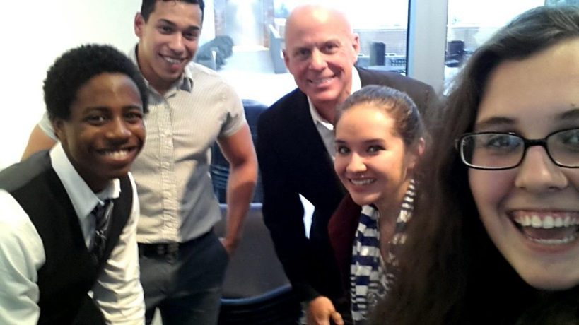
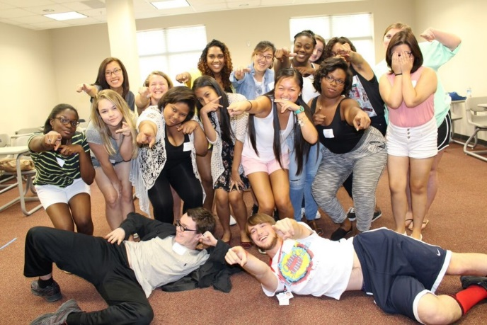
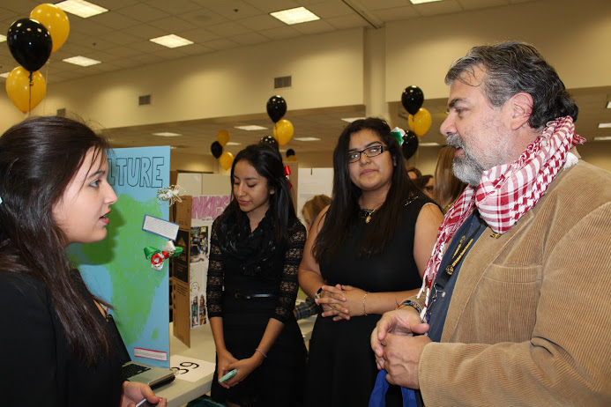
Learning Communities:
What’s In It for ME?
Dr. Carmen Skaggs, CHSS Associate Dean for Academic Support
Ms. Cathy Bradford, Director, Learning Communities Program
Dr. Hillary Steiner, Associate Director, Learning Communities Program
Insert CHSS logo here

Slide 2
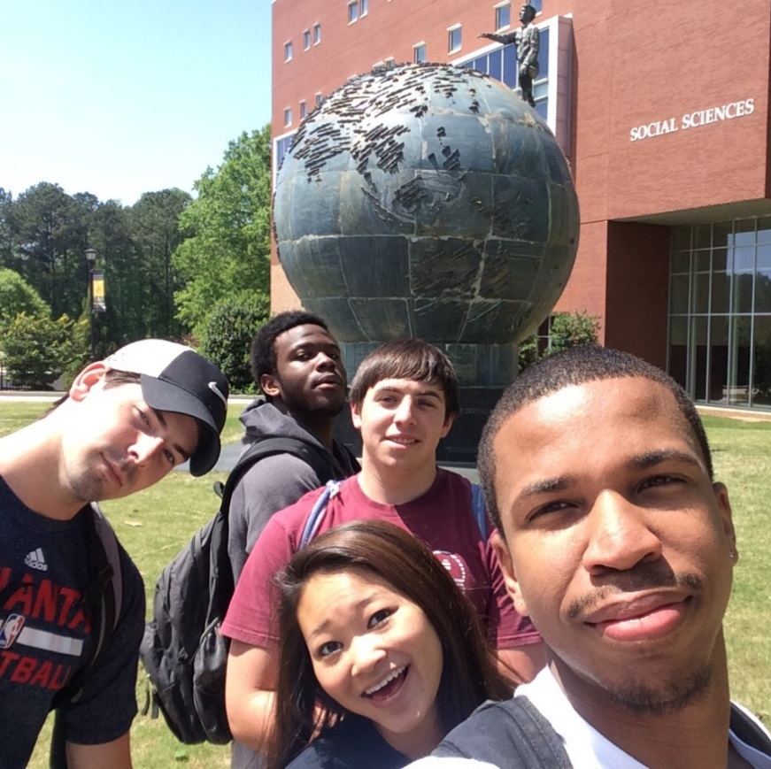
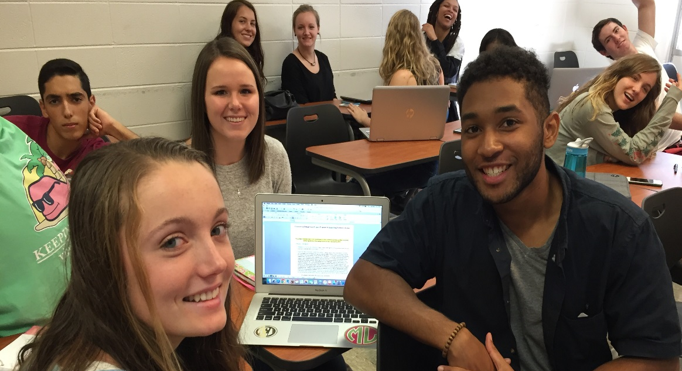
What are Learning Communities?
Two or more courses linked by a common theme. The same 25 students (or fewer) co-enroll in all courses in the learning community.
Faculty teaching LC courses work together to create assignments and activities that cross course boundaries – thereby helping students connect what they are learning in disparate courses.
LCs provide faculty with an ideal environment for modeling and encouraging higher levels of thinking.
LCs provide students with a great way to make friends, form study groups, connect to faculty and gain an immediate sense of belonging on a very large campus.
LCs provide the university with fantastic RPG numbers and a HIP to brag about!

Slide 3
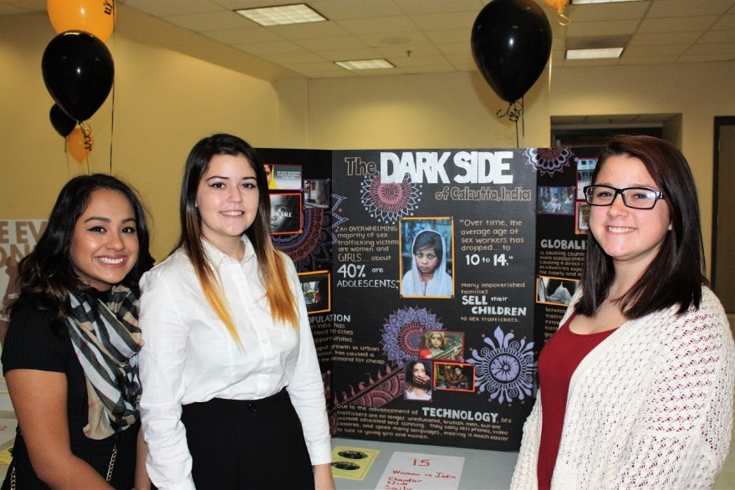
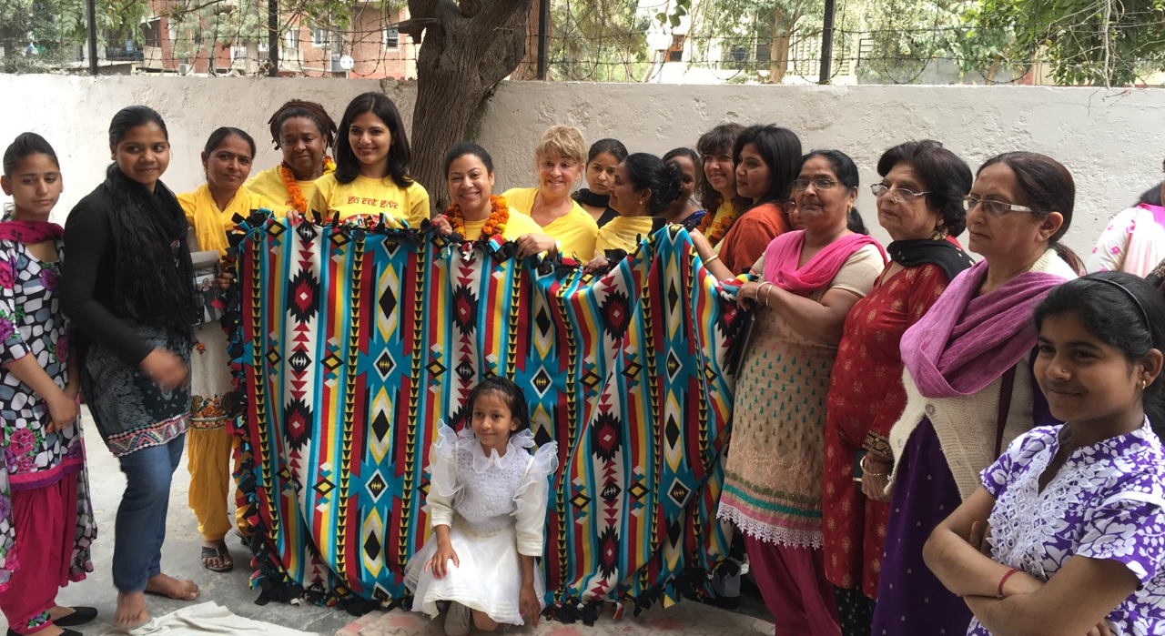

Slide 4
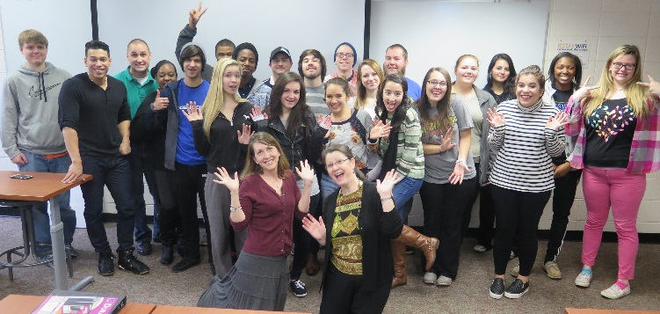
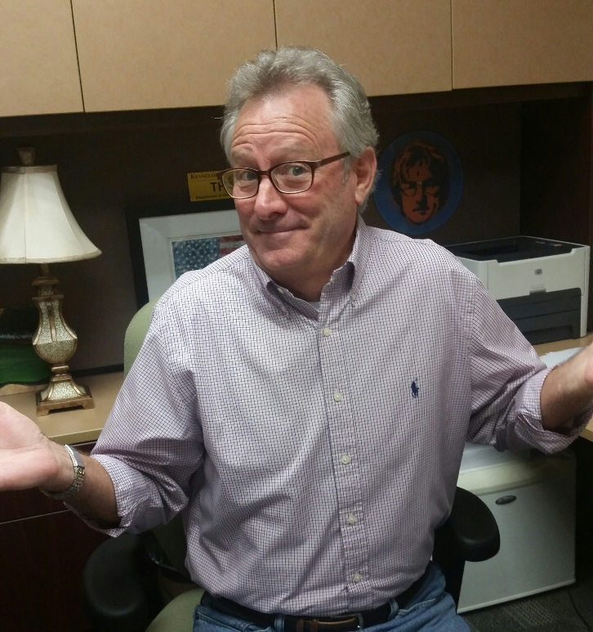
Why in the world would I want to teach first-year students?
Avoiding the “associate professor slump…”
“For a remarkable number of faculty, the first-year experience program provides a kind of professional renewal that becomes its own success.”
~Betty Siegel, 2005, p. 179
Dr. Chuck Wynn
Associate Professor of History
You are setting the stage for a student’s college experience, teaching them:
How to think like a scholar
How to function as part of a community
How to interact with faculty and peers

Slide 5
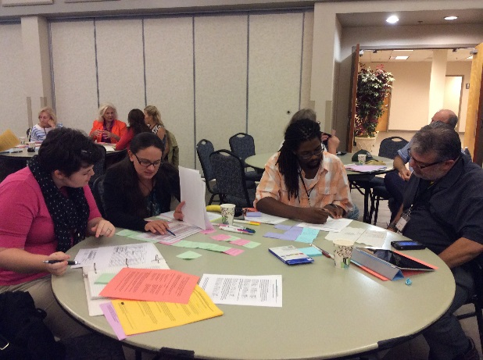
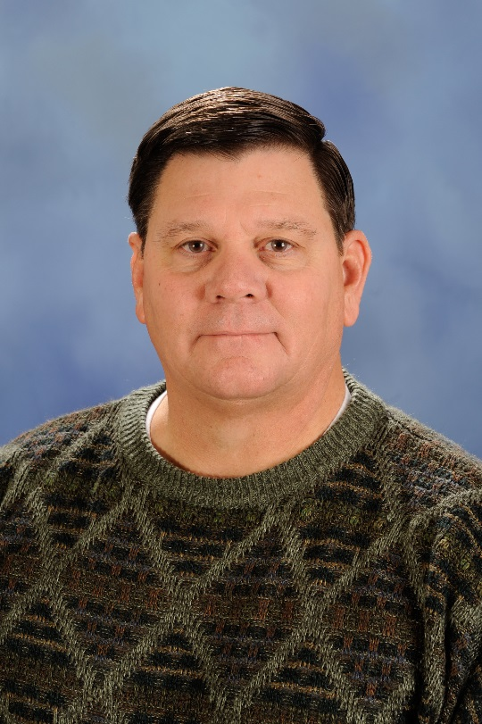
This sounds like a lot of extra work. I’m afraid I don’t have time!
What Do We Expect from LC Faculty?
Individually:
Complete a short online training course (found on D2L)
Incorporate the theme into your class
As a Team:
Plan at least one integrative assignment
Plan at least one out-of-course activity that faculty and students attend together
Review each others’ syllabi to ensure tests/projects aren’t assigned on the same day
Communicate during the semester
Dr. Stan Crowder
Assistant Professor of Criminal Justice

Slide 6
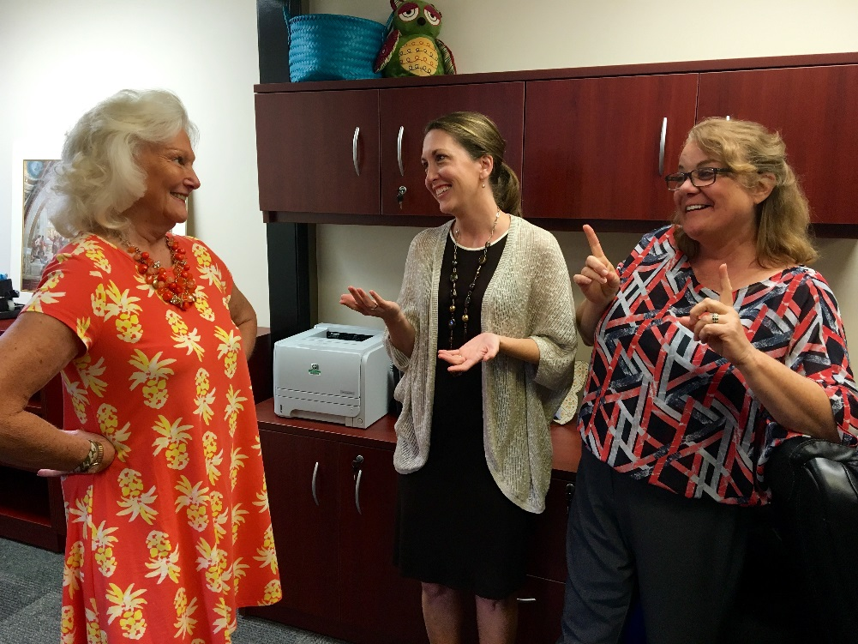
But you said 25…my class has a lot more than 25 students in it.
At least one class in the learning community must be small, including only LC students.
Other classes may have those 25 students embedded within a larger class.
N = 250
N = 25
ENGL 1101
N = 25
Dr. Gail Scott
Senior Lecturer of Psychology
N = 25
PSYC 1101
KSU 1101

Slide 7
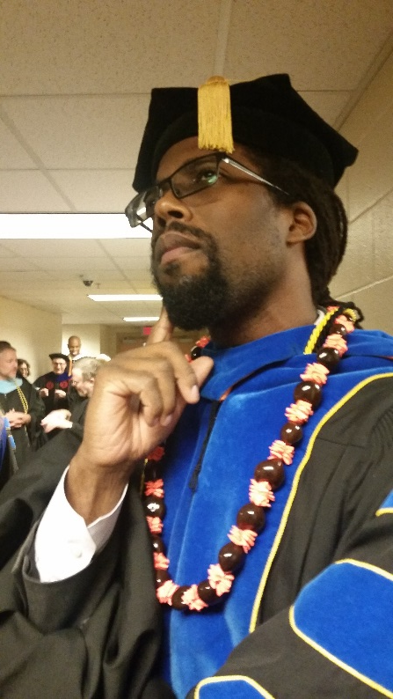
OK, but…
I’m trying to get promoted. How does this help me in P&T?
In the area of TSM…
Teaching in an LC documents your motivation to go above and beyond expectations
The LC Program promotes and provides support for scholarly teaching (KSU Faculty Handbook, 3.4.A)
In the area of RCA…
The Scholarship of Teaching and Learning (SoTL) is one of the recognized areas of research productivity (KSU Faculty Handbook, 3.3.B)
The LC Program encourages SoTL projects and offers tailored professional development as well as one-on-one SoTL consultation
Dr. Seneca Vaught
Associate Professor of History
We will provide letters for your portfolio indicating LC participation. Upon request, and based on submitted evidence, we will provide a detailed letter that indicates how you’ve put scholarly teaching into practice!

Slide 8
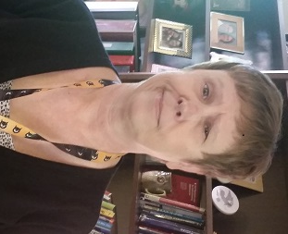
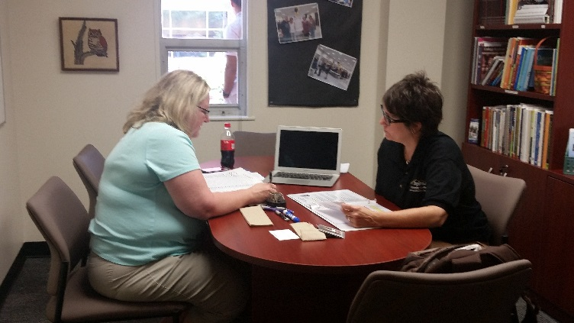
LC Mini-Grant Program
LC teams may apply for funding for up to $500 for a creative teaching idea that meets one of the LC Program outcomes
Grant proposals are reviewed by the LC Advisory Council, consisting of faculty and staff from across both campuses
Yeah, but… do I get any kind of incentives for doing this?
Other Incentives
Tailored faculty development
Use of the LC Lounge and Lending Library
One-on-one consultation for assignments and SoTL projects
Dr. Carola Mattord
Lecturer of English

Slide 9
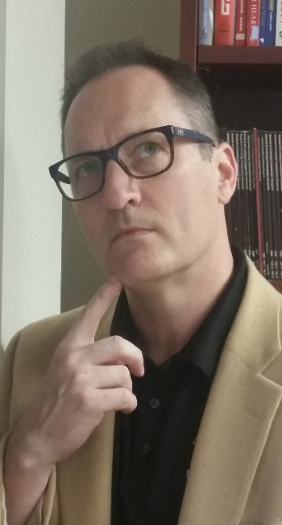
Hmm. What else will I get out of this experience?
A chance to work with faculty in other disciplines
A chance to collaborate on integrative assignments
A chance to incorporate a theme or “big question” into your class
A chance to target (or recruit) incoming majors
Dr. Chris Hutt
Assistant Vice President & Executive Director of Academic Advising

Slide 10
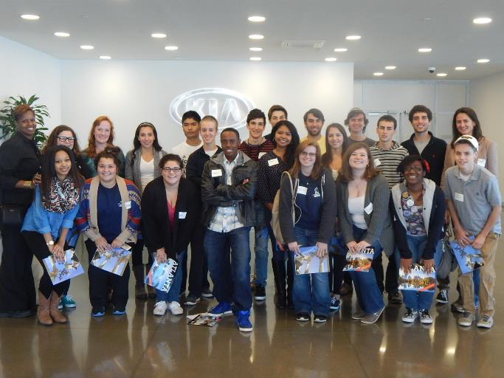
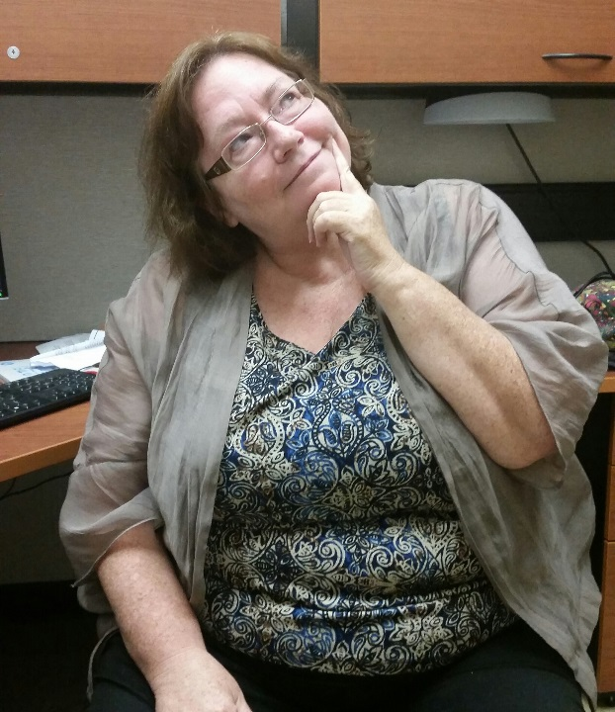
I’m almost convinced. I think I’d like to hear from someone who’s done it before.
Faculty Testimonial:
Dr. Vanessa Slinger-Friedman
Associate Professor of Geography
Winner of the 2016 Regents’ Scholarship of Teaching and Learning (SoTL) Award
Dr. Vicki Armour-Hileman
Lecturer of English

Slide 11
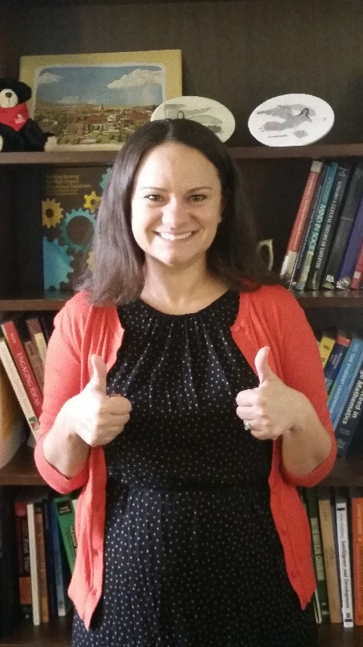
LC Proposal Process
LCs are proposed by the faculty who teach in them.
Online submission – www.kennesaw.edu/learningcommunity
Approval Process – Proposals are reviewed by the LC Advisory Council, consisting of faculty and staff from across both campuses
Call for Proposals
Spring 2017 LCs
August 29-September 12, 2016
Fall 2017 LCs
October 10-November 11, 2016
I’m ready! How do I sign up??!!
Mandy McGrew
Part-Time Instructor American Studies

Slide 12
