Slide 1
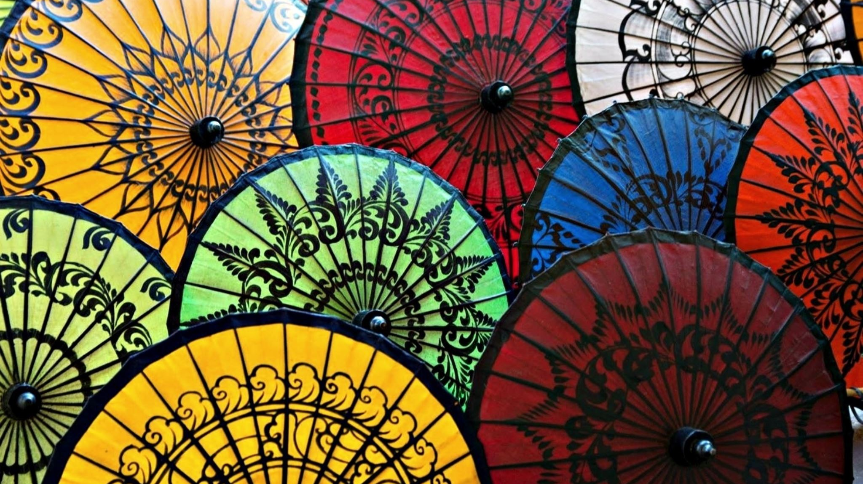
Aegis Digital Museum & Maker’s Space
DR. LYDIA E. FERGUSON
KSU ENGLISH & INTERDISCIPLINARY STUDIES

Slide 2
The Vision in 3 Core Concepts: Creating a public-education resource that is
Ethical
Accessible
Sustainable

Slide 3
Many KSU students want to work in/with fields like game development, virtual reality, computer science, marketing, data analysis, ethics, language, accessibility, sustainability, etc., and many of these same students are likewise concerned with the preservation of varied stories and authentic voices.
The Aegis Digital Museum & Maker’s Space are public-education resources designed to direct and house remarkable student work that 1) contributes to the fields within the Humanities & Social Sciences and 2) provides KSU students with professional-development experiences they’ll be proud to reference in resumes, applications, and interviews.
Additionally, we are working to create a Marietta Maker’s Space: a Hands-on Museum & Humanities Studio aimed at the following student-success initiatives:
1) bolstering interdisciplinary engagement and collaboration amongst Humanities and STEM interests at KSU; 2) exposing students to increased local (KSU), national, and international publication, conference, and internship opportunities; 3) providing General Education students with relevant and valuable experiences that 4) aid in building resumes that secure KSU graduates rewarding jobs and lives.

Slide 4
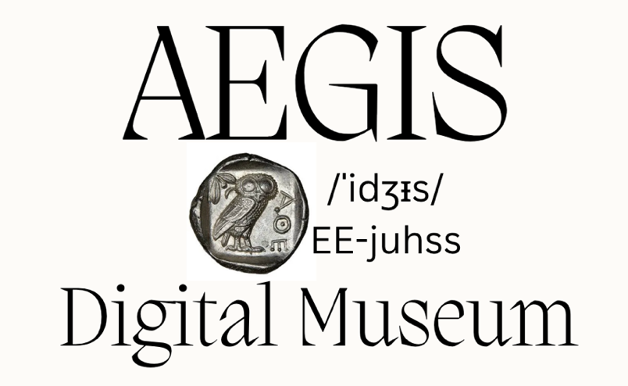
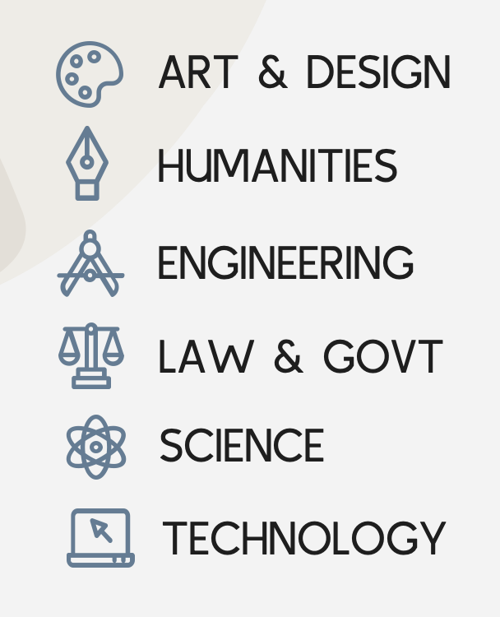
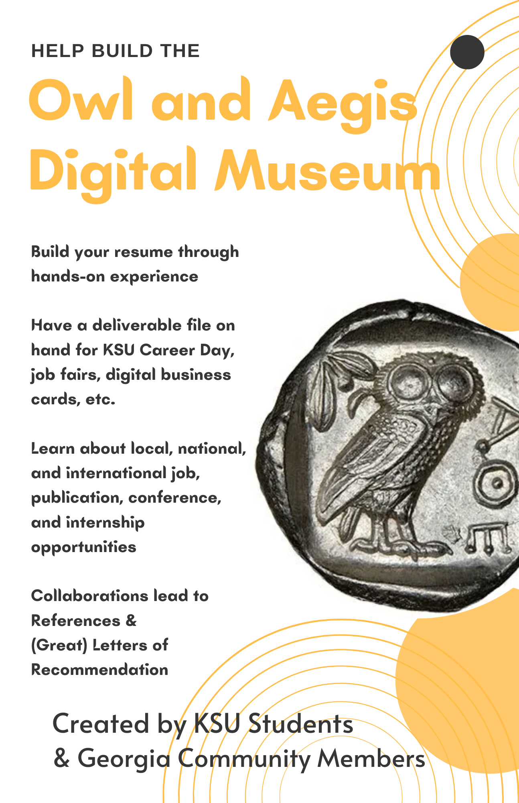
The Aegis Digital Museum
is a Public Education Resource created by
KSU students & Georgia community members.

Slide 5
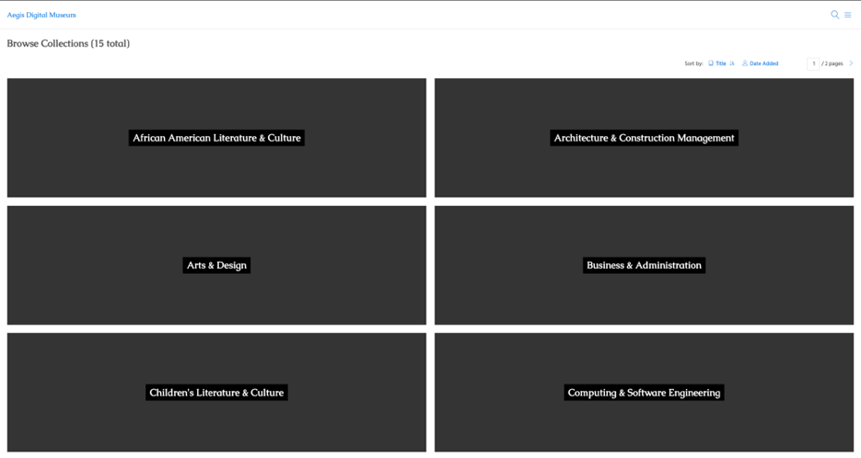
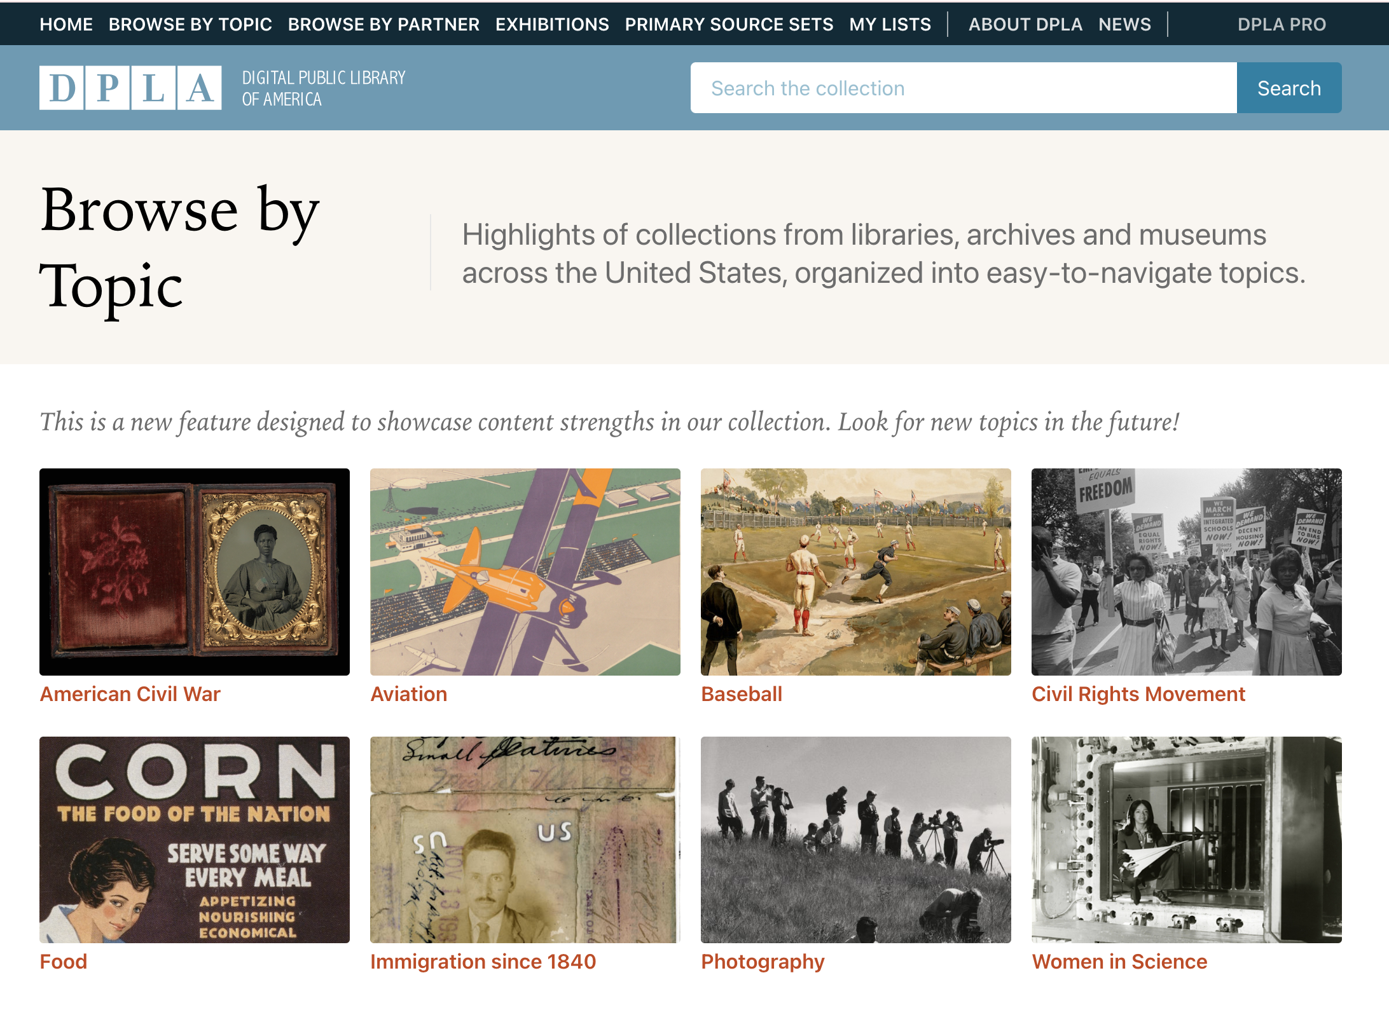
Current Look vs Goal
https://aegisdigitalmuseum.kennesaw.edu

Slide 6
ENGL 1101 & 1102: First-Year Composition (Examples)
ENGL 1101: Intangible Rhetorics
Departing from conventional textual examinations of rhetoric, ENGL 1101: “Intangible Rhetorics” invites students to explore the preservation and adaptation of intangible cultural heritage in contemporary life, including but not limited to language, folklore, sustainability practices, dance and music, rites of passage, and foodways. Students will develop their skills in rhetorical analyses, practical research, and multimodal composition by examining the role of heritage in the forming and maintaining of community and cultural identity. We will trace the ways in which globalization, technology, and popular culture have not only impacted the present, but chart their instrumental functions in safeguarding intangible heritage through digital storytelling.
ENGL 1102: Material Cultures
As an alternative to the written word, cultural artifacts historicize the lives of both objects and people in profound and unforeseen ways. In ENGL 1102: “Material Cultures,” students will choose a cultural artifact for a semester-long research project, and in writing about material culture, will learn about the origins, applications, impacts, and evolutions of their objects, and about the people who made, sold, bought, and used them. As a final deliverable for the course, students will work with historical, archival, and contemporary academic research to curate/compose exhibits for the Aegis Digital Museum, a public-education resource focused on shielding both the extraordinary and everyday histories of people, places, and things that impact our society and world at large.

Slide 7
GWST 1102: “Love & Sex”
The Final Portfolio Project consists of a final artifact or deliverable that students create out of (and in addition to) Semester Research Portfolios.
Digitize a primary source made available for student use and create an entry for the digital museum. This would consist of media files (high-resolution scans, images, video, sound recordings) and written descriptions, profiles, etc.
Digitize/preserve/make accessible an artifact(s) you have access to, either from your own collection, or that of a family member, friend, elder, or local community organization, etc.
Curate an exhibit-worthy Wunderkammer, or cabinet of curiosities, via an Interactive Bibliography.
Propose a project—individual or collaborative—related to your portfolio research that you’d be proud to pull up in an interview and/or put on your resume, and that, if possible, contributes to a repository of public-education resources (Infographic/Poster, Collage, Timeline, Art Portfolio, Comix, Architecture Software Presentation).
Aid in the creation/design/functionality/scope/data collection of the digital museum. Since this database is a completely new endeavor, hone your skills and develop new ones by helping to get it up and running.

Slide 8
Current GWST 1102: “Love & Sex” Projects
Major:
Nursing
Major:
Architecture
Major: Computer Game Design & Dev
Gendered Spaces
Gender-Identity Comix on Asexuality
Maternal Mortality Rates of Black Women

Slide 9
The Aegis Maker’s Space
would be a Hands-on Museum & Humanities Studio for KSU’s Marietta-campus students and faculty.
Digitization & Preservation Lab
Artifact Remix Lab (getting crafty)
Interactive Narratives & Games Preservation Lab (e.g., gaming “play station”)
Podcast & Storytelling Booths (composition, literature, history)

Slide 10
How might a Maker’s Space enhance instruction opportunities for your students?
To procure space we need to argue it will be beneficial to KSU students on the Marietta campus looking to incorporate Humanities & Social Sciences perspectives into their work in STEM.

