Slide 1
Flipping the Classroom
Christopher L. Pallas, PhD
School of Government and International Affairs
Kennesaw State University
Email: cpallas@kennesaw.edu
Notes:
Line spacing + Page numbers

Slide 2
Christopher L. Pallas
PhD London School of Economics
Postgraduate Certificate in Higher Education
Professor of Political Science
Faculty Fellow for Graduate Student Support at CETL
Author of Doctoral Student Skills: Using Your Comparative Advantage to Succeed in Grad School and Prepare for the Job Market (Routledge, 2023)

Slide 3
Agenda
01 What is Flipped Classroom Teaching?
02 Benefits to Students and Instructors
03 Implementation
04 Comments and Discussion

Slide 4
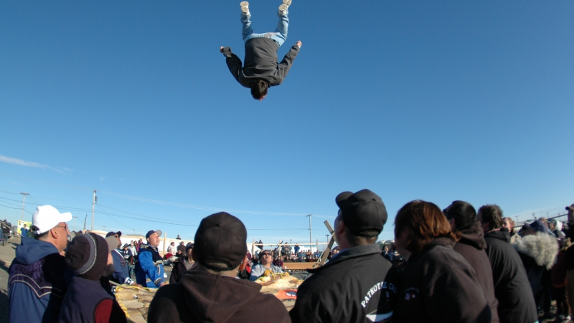
01 What Is Flipped Classroom Teaching?
This Photo by Unknown Author is licensed under CC BY-NC-ND

Slide 5
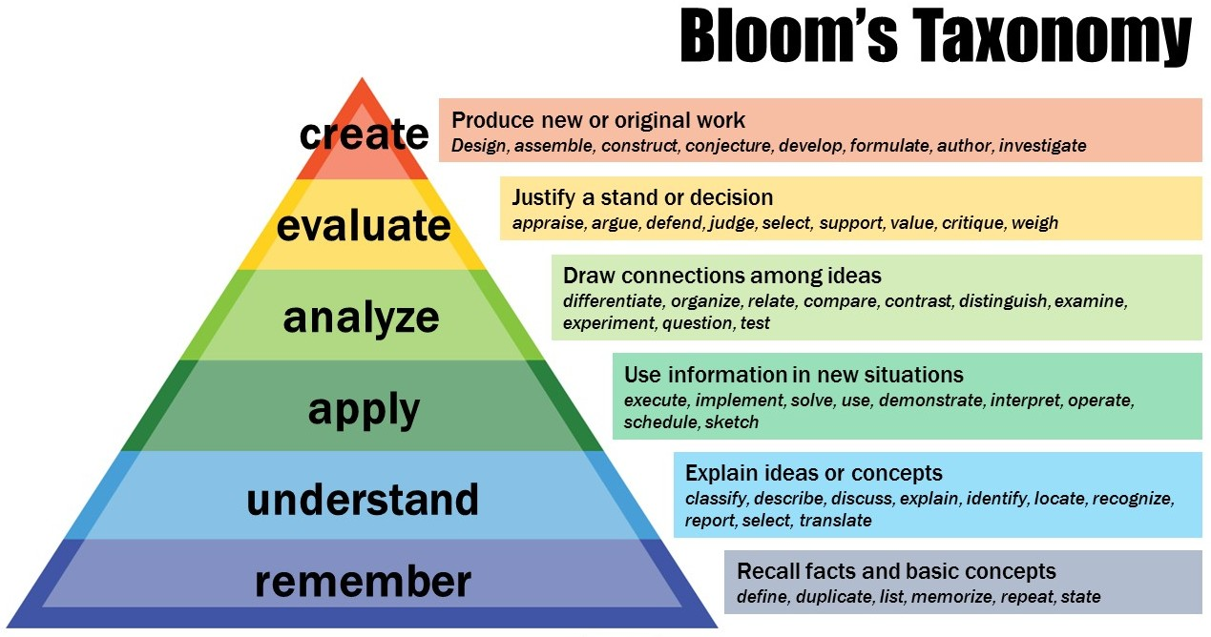
Exercise 1a: Defining the Term
1: What is flipped logistically in a flipped classroom? I.e., how does the sequence of teaching change?
2: What is flipped cognitively in a flipped classroom? I.e., how does the focus of cognitive activity change?
This Photo by Unknown Author is licensed under CC BY-NC

Slide 6
Inverting Exposure and Application
In Class
Outside Class
Initial exposure via lecture, demonstrations
Application: Problem sets, blog posts, essays
Traditional
Flipped
Application: Problem-solving exercises, peer-to-peer education
Initial exposure via readings, video, or podcasts

Slide 7
Defining the Approach
“The flipped approach inverts the traditional classroom model by introducing course concepts before class, allowing educators to use class time to guide each student through active, practical, innovative applications of the course principles”
(Academy of Active Learning Arts and Sciences, 2018)

Slide 8
Flipping the Focus of Cognitive Activities
Flipped
Traditional
Outside class
In class
In class
Outside class
This Photo by Unknown Author is licensed under CC BY-NC

Slide 9
Exercise 1b: What Are You Flipping?
1: When are your students exposed to new material – before, during, and/or after class/training?
2: When do your students engage in higher-level cognitive activities?
Inside or outside of class?
What kinds of activities?
How often?
This Photo by Unknown Author is licensed under CC BY-NC

Slide 10
Example: Intro to International Relations
Pre-class
2-3 theory readings (e.g., a textbook section on Liberalism and Wilson’s 14 Points speech) + 1 current events article
In Class
Round 1: Confirm completion of pre-class work + Understanding
Small groups (SG): Students define key terms and concepts from each reading. Example: “Define the terms reciprocity and interdependence. Explain how Liberals believe each affects state behavior.”
Instructor visits each group to ask questions and informally assess progress
Large group discussion (LG): Instructor collects answers from each group, confirms correct answers, and organizes on board
Round 2: Analyze readings
SG: Students answer questions challenging them to identify links between key readings and concepts. Example: “How do Wilson’s 14 points reflect Liberal beliefs about how the international order can evolve or change?”
Instructor visits each group to assist or challenge
LG: Collect answers from each group and organize on board
Round 3: Evaluate/Create
SG: Students apply the readings to evaluate the behavior of actors in current events and formulate new ideas. For example: “Using Liberal theory, develop an argument for what actions the US should take to restore peace In Ukraine.”
Instructor visits each group to assist or challenge
LG: Collect answers and facilitate debate between groups with differing views

Slide 11
02 Benefits to Students and Instructors
This Photo by Unknown Author is licensed under CC BY

Slide 12
Exercise 2a: Benefits
If we were continuing in true flipped classroom style, we would proceed to a further discussion of class readings:
In what disciplines has flipped classroom been effectively used?
How does flipped classroom teaching benefit students?
Based on the research, what benefits might you anticipate for instructors?

Slide 13
Exercise 2b: Class Dynamics
What strategies do you currently use to assist students who: Regularly miss class? Come to class unprepared? Fall asleep? Become distracted by devices?
Do you look forward to teaching?
Do you students look forward to class?

Slide 14
What the Research Says
Extensive literature on flipped classroom. Some examples:
Lage, Platt, and Treglia (2000). “Inverted classroom.” Pre-class video lecture + in class discussion and applied exercises for economics students.
Deslauriers, et al. (2011). Interactive lecture vs. flipped for large physics classes. Flipped yielded almost double the level of student engagement and test scores 33 percentage points higher.
Malek, et al. (2022). Review of 21 studies in humanities and social sciences found positive impacts on “academic, personal, social and cognitive skills.”
Strelan, Osborne, and Palmer (2020). Cross-disciplinary meta-analysis, including 174 tertiary-level studies (out of 198) and 33,687 students.
Positive effects on student performance across all disciplines
Tests of moderating variables indicated that effects are not dependent on class size or specific activities but instead linked to opportunities flipped classrooms provide for “structured, active learning and problem-solving.”

Slide 15
Improving the Student Experience
The flipped classroom describes “pedagogical approaches that:
(1) move most information-transmission teaching out of class
(2) use class time for learning activities that are active and social
(3) require students to complete pre- and/or post-class activities to fully benefit from in-class work”
(Abeysekera & Dawson, 2015)
Self-paced pre-class work helps students manage cognitive load (Abeysekera & Dawson 2015; Jdaitawi, et al. 2022)
Class time is active and social (Lage, et al. 2000; Abeysekera & Dawson 2015)
Accountability for completing out-of-class work, often via positive peer pressure (Abeysekera & Dawson 2015)
Instructor is present when students are undertaking the most challenging cognitive tasks (Schell & Mazur 2015; cf. Lage, et al. 2000)
Receive coaching or clarification - without coming to office hours (Schell & Mazur 2015)
Real-time feedback on understanding and performance (Schell & Mazur 2015; Deslaurier, et al 2011)

Slide 16
Benefits to the Instructor
Improved student engagement
Leverage positive peer pressure
Energized classroom environment
Get to know students better
Informal assessment of student progress in every class
Easier to address needs of low/high performing students
Happier students
Saves time – “Make the students do the work!”

Slide 17
Requirements and Challenges
Deliberately orient students to new format
Identify or create appropriate materials for pre-class exposure
Create means of holding students accountable to do pre-class learning
Respond flexibly to students in class
Possible trade-offs: less information for greater comprehension and retention
“The [flipped classroom] style of teaching was something I was afraid of when I first heard it. I spent sixteen years of my life learning from lectures so something like this is like trying to use an F1 car to go off roading I thought. It is the complete opposite of how we as students were wired to learn. It oddly enough worked well, and in fact I wish more professors did this or at least hybridized it with lectures. I am writing my final paper right now, and it is amazing just how much I now know about something I was ignorant of five months ago. I still have to look in my notes and articles for specifics, but I can say that [this] teaching style is the best way to teach once you rewire your brain to work with it.”
KSU student on teaching evaluation

Slide 18
Exercise 2c: Benefits and Costs
Based on your answers to Exercise 2b, consider the following:
How might a flipped classroom approach benefit your students?
How would it benefit your best students?
How would it affect average or underperforming students?
How might it affect current problems in the classroom?
How might a flipped classroom approach benefit you as an instructor?
What possible costs or challenges do you see with adopting a flipped classroom approach?

Slide 19
03 Implementation
This Photo by Unknown Author is licensed under CC BY

Slide 20
Exercise 3: Starting Position
How closely does your current lesson plan resemble flipped classroom style?
How much information is imparted before class?
What is the balance between transmitting information vs applying it in your class?
What cognitive levels are emphasized in class?

Slide 21
Creating Your Flipped Classroom Lesson Plan: Overview
Step 1: Learning Objectives and Measurement
Answer individually the questions posed on the slide (10 minutes)
Step 2: Select Pre-Class Work
Answer individually the questions posed on the slide (15 minutes)
Discuss in pairs answers to questions from Step 1 and Step 2 (10 minutes)
Step 3: In-Class Exercises
Answer individually the questions posed on the slide (10 minutes)
Discuss in pairs and brainstorm additional activities (15 minutes)
Step 4: Execute
In groups of 4, practice explaining the new approach to students (15 minutes)

Slide 22
Step 1: Learning Objectives and Measurement
Learning Objectives:
What do you want your students to know or understand at the end of this lesson?
What do you want your students to be able do by the end of this lesson?
Which elements are most important/foundational?
Which elements are most complex or difficult?
Preparing for Assessment:
How will you measure or assess students’ learning outcomes related to this lesson when determining their semester grades?
How can this lesson provide scaffolding to help them prepare or practice for that assessment?

Slide 23
Step 2: Select Pre-Class Work
What will you assign before class to expose students to the material?
Comprehensive + manageable. Exposure must provide complete information on the subject without relying on in-class lecture
Thought experiment: What material, if a student understood it perfectly, would be sufficient for them to earn an A on their final assessment?
Consider modalities and accessibility
How will you assess pre-class learning and hold students accountable to complete the pre-class work?
Pre-class options (e.g., JiTT quiz)
In-class options (e.g., clicker responses; small group exercises)
This Photo by Unknown Author is licensed under CC BY

Slide 24
Step 3: In-Class Exercises
Plan Small Group Exercises
Work through levels of Bloom’s Taxonomy, starting from Understand or Apply
Simple: Working in groups of 3 to 5 to answer instructor questions or complete problems
Complex: Imaging or creating scenarios, reports, or new problems
Select exercises that will scaffold toward final assessment
Check Timing
What is your standard class length?
How much time will your planned exercises take? Include time to explain the exercise, student activity, and instructor-led follow up or debrief
Leave 5-10% of class time as margin
What will you cut?

Slide 25
Step 4: Execute!
One Class Prior:
Prepare your students for doing the pre-class work
Day of Class:
Optional: Arrange your classroom
Explain to students what you are doing and why
Divide into groups of 3-5
Coach exercises
Optional: Print photo roster
Listen in and ask questions – lead, probe, and challenge!
One Class After:
Plan debrief of lesson and solicit feedback

Slide 26
Flipping the Classroom: Summary
Core Concepts
Move information transmission from in-class to pre-class
Require pre-class learning
Key Benefits
Engaged students
Reduced prep time
Implementation
Identify one lesson to start
Select materials and exercises that support key learning objectives and prepare students for assessment
Use class time for active, social, applied learning
Superior scaffolding
Improved learning outcomes
Execute, reflect, and seek feedback
Continual assessment
Adaptability
This Photo by Unknown Author is licensed under CC BY

Slide 27
04 Questions and Comments

Slide 28
References
Abeysekera, L., & Dawson, P. (2015). Motivation and cognitive load in the flipped classroom: definition, rationale and a call for research. Higher education research & development, 34(1), 1-14.
Academy of Active Learning Arts and Sciences (2018). Updated definition of flipped learning. https://aalasinternational.org/updated-definition-of-flipped-learning/
DesLauriers, L., Schelew, E., and Wieman, C. (2011). Improved learning in a large-enrollment physics class. Science 332: 862-864
Lage, M. J., Platt, G. J., & Treglia, M. (2000). Inverting the classroom: A gateway to creating an inclusive learning environment. The journal of economic education, 31(1), 30-43.
Jdaitawi, M., Hussein, E. T., Muhaidat, F., & Abu Joudeh, M. (2022). Probing the flipped learning literature in social sciences and humanities education. International Journal of Instruction, 15(3), 677-694.
Schell, J., & Mazur, E. (2015). Flipping the chemistry classroom with peer instruction. In García-Martínez and Elena Serrano-Torregrosa (eds.) Chemistry education: Best practices, opportunities and trends, 319-344.
Strelan, P., Osborn, A., & Palmer, E. (2020). The flipped classroom: A meta-analysis of effects on student performance across disciplines and education levels. Educational Research Review, 30, 100314.

