Slide 1
Time Hacks for Grading: Saving Your Sanity While Also Engaging Students
Amy Sandefur, Senior Lecturer of English
asandefu@kennesaw.edu

Slide 2
Strategies for grading efficiently while still being effective:
Attendance Checks
PEW Responses
Level 2 Exam questions
Audio Feedback

Slide 3
Attendance Checks
Attendance grade earned by completing class activities
Done for a completion grade so are quick to grade but call for student engagement
Each activity is low stakes, but they add up to 10-15% of the course grade
I assign more than are needed so that a few can be dropped, and with this I don’t usually allow make ups

Slide 4
Attendance Checks
Responses to prompts (short: one word to 1-3 sentences) to elicit discussion
Index cards
D2L "Assignments"
Google docs
Notes on small group discussions
Student-led questions for discussion
Drawings
Padlet (virtual bulletin board)
Surveys/Polls
Kahoots (game)

Slide 5
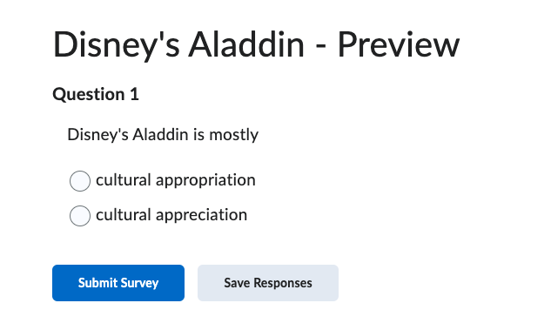
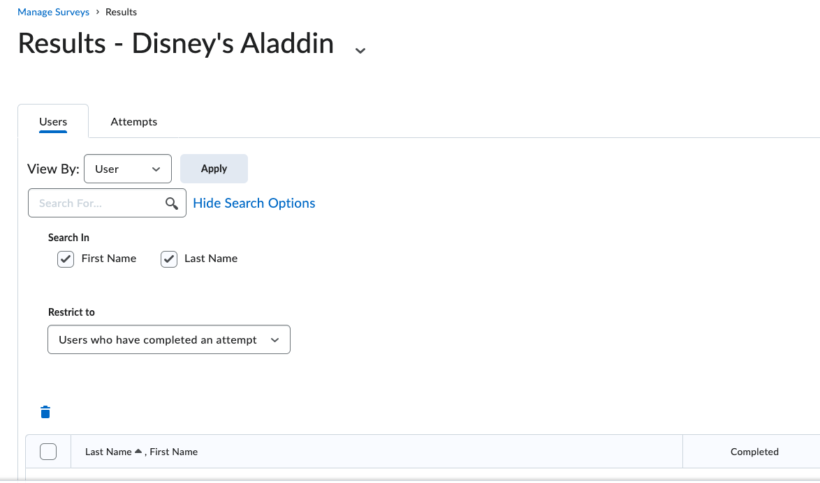
D2L Surveys

Slide 6
Kahoot

Slide 7
Kahoot

Slide 8
Padlet

Slide 9
PEW Responses

Slide 10
PEW Responses: D2L Rubric

Slide 11
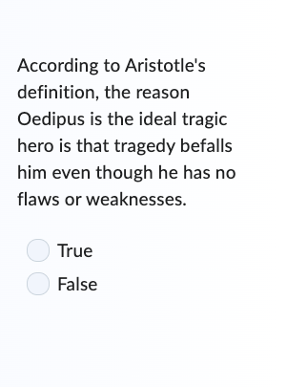
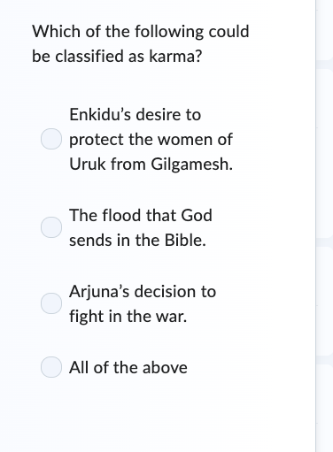
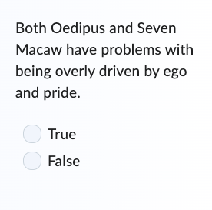
Exam Questions
Exam questions that require higher level thinking

Slide 12
Voice Recording or Feedback

