Slide 1
GIS and geography Textbook Grants
Uli Ingram
Kennesaw State University

Slide 2
outline
Definition of OERs
ALG/funding for OERs
Types of OER grants
Reasons to use OERs
Challenges of using OERs
Creative Commons Licenses
Platforms for OERs
Supplementary Resources
Using OERs in GIS courses at KSU
Example of Cartography OERs
Assess Effectiveness of OERs
Funding for OERs
Links to OERs
Additional Resources/Information

Slide 3
Open educational resources
Definition: OER are freely and publicly available teaching, learning, and research resources that reside in the public domain or have been released under an intellectual property license that permits their free use and re-purposing by others.
Source

Slide 4
Affordable learning Georgia (alg)
A University System of Georgia (USG) initiative
“Affordable Learning Georgia promotes student success and fosters educational equity through its programs to boost the use of affordable and open educational resources.”
Provide cost savings to students
Provide funding to faculty to choose Open Educational Resources (OER) rather than traditional, expensive textbooks
https://www.affordablelearninggeorgia.org/

Slide 5
Types of ALG grants
Textbook transformation grants
Improvement grants
Research grants

Slide 6
Main reasons to use oeR
Savings for students
Control over materials
Keeping the materials up to date and staying in sync with software updates

Slide 7
Challenges/problems
Challenges when working on a textbook grant
Amount of work and time
Potential workload/teaching assignment changes
Existing OER resources might disappear
Broken links
Poor course evaluations (maybe the first semester)

Slide 8
Creative commons licensing
Attribution (CC BY)
Attribution-ShareAlike (CC BY-SA)
Attribution-NoDerivs (CC BY-ND)
Attribution-NonCommercial (CC BY-NC)
Attribution-NonCommercial-ShareAlike (CC BY-NC-SA)
Attribution-NonCommercial-NoDerivs (CC BY-NC-ND)
Public Domain Mark (CC0)
https://creativecommons.org/

Slide 9
Format/platform for OER materials
Softchalk
Google Docs
D2L files/links
ArcGIS Storymap
Other options

Slide 10
Supplementary resources
Some OER include additional resources:
Quizzes
Question banks
Self-Assessments
Videos (depends on instructor)
And others

Slide 11
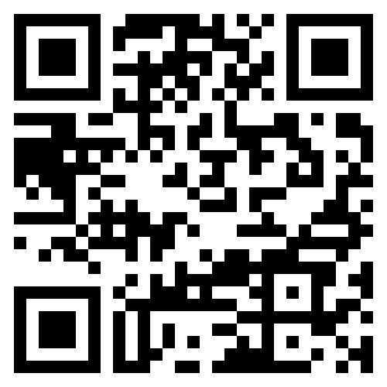
Gis Oer resources
Link to Earth from Above Readings

Slide 12
Gis Oer resources
Link to Cartography Readings
Cartography Labs

Slide 13
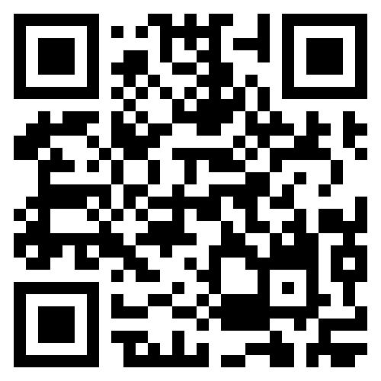
Gis Oer resources
Link to Intro to GIS Readings
Intro to GIS Labs

Slide 14
Additional Resources
Finding OER Resources:
https://www.affordablelearninggeorgia.org/resources/find/overview/
Evaluating OER Resources:
https://guides.library.ucdavis.edu/open-educational-resources/evaluate
https://libguides.cmich.edu/OER/evaluating
OER Accessibility:
https://alg.manifoldapp.org/projects/oer-accessibility-series-and-rubric
Creative Commons/Licensing Information:
https://www.affordablelearninggeorgia.org/resources/create/open-licensing-and-copyright/

Slide 15
contact
Email: uingram@kennesaw.edu

