Slide 1
Radow Student Success Summit Globally Motivated: Enhancing student engagement through international community online
May 13, 2024 Abigail Alexander (WLC)
aalex100@kennesaw.edu

Slide 2
Don’t hesitate to ask questions or interject!

Slide 3
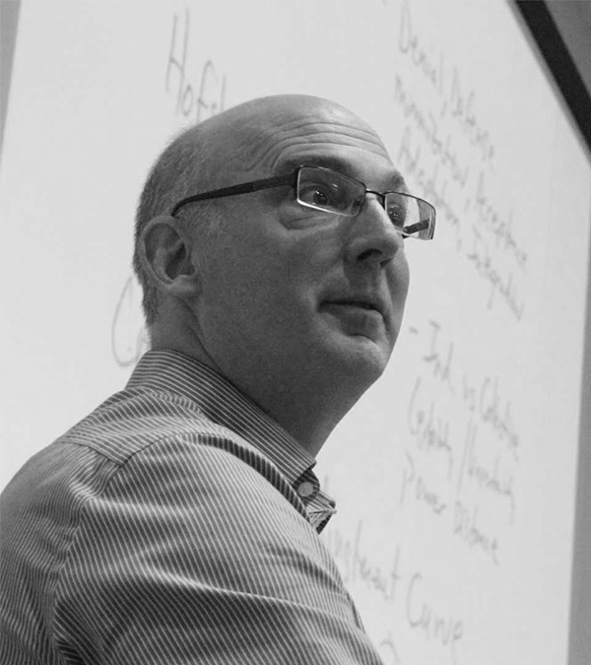
I. Background
Inherited strong virtual exchange (VE) institutional relationship between KSU and Université Hassan II Casablanca
Piloted French program in fall 2023 (in 2 FREN courses) and continued in spring 2024 (in 1 FREN course)

Slide 4
Job Readiness Transferable Skills Students Gain from VEs

Slide 5
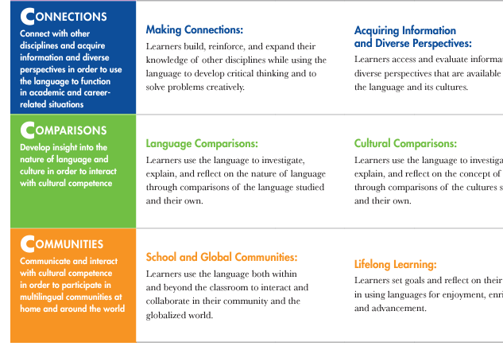
II. Motivation
Community Building
Real-World Utility
Active Members of Global Society
Boost Enrollment & Retention to Minor/Major

Slide 6
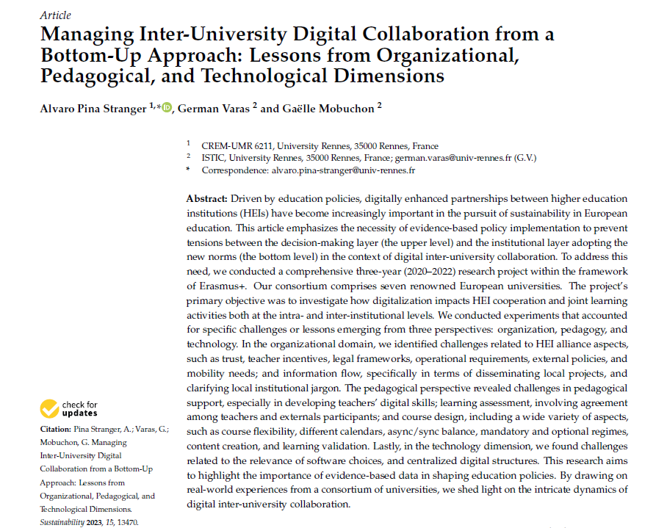

Slide 7
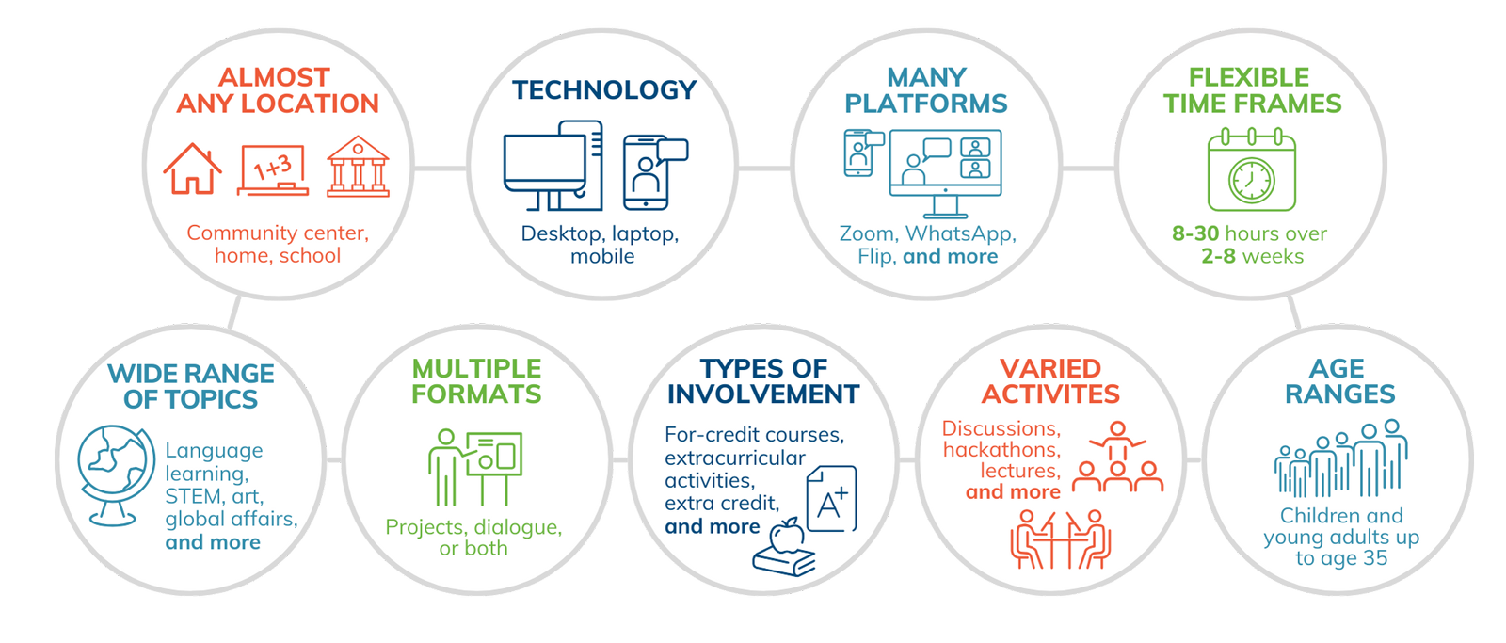
Questions for Participants
Would these motivators apply to your program?
Are there other reasons a VE appeals to you?
In which international area would you ideally seek a partner university or organization?
What challenges can you imagine encountering?

Slide 8
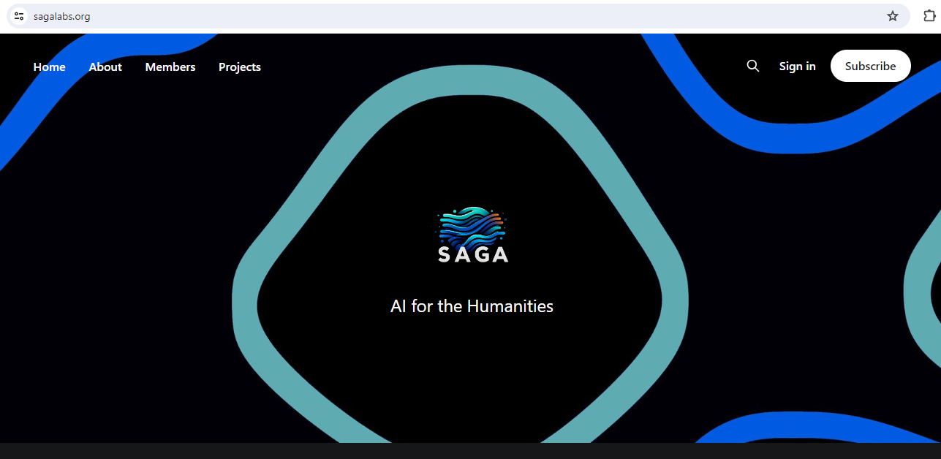
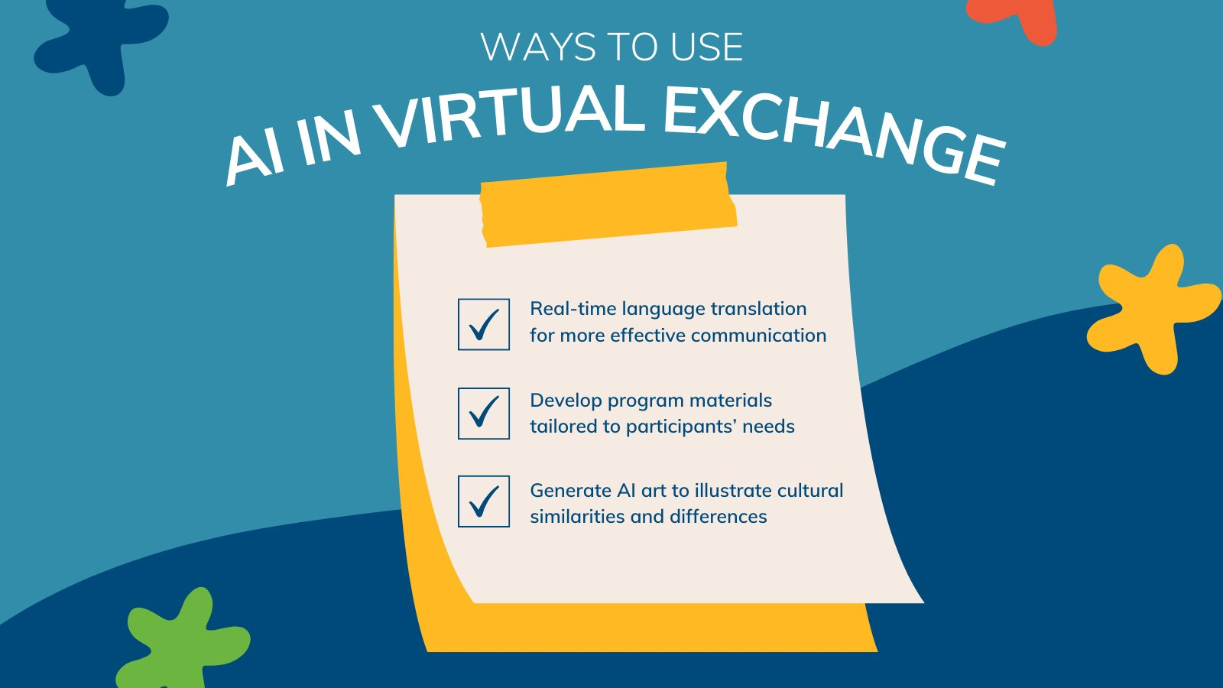
III. Implementation
Coordination - WhatsApp & Google Classroom
Modifications for Modality
Saga Lab AI Support
NEH Humanities Initiatives Grant

Slide 9
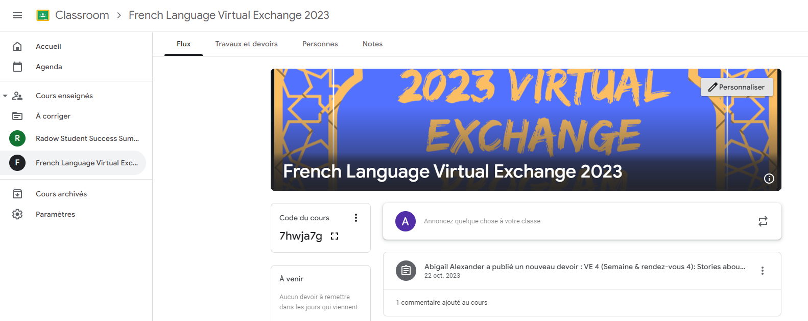

Slide 10
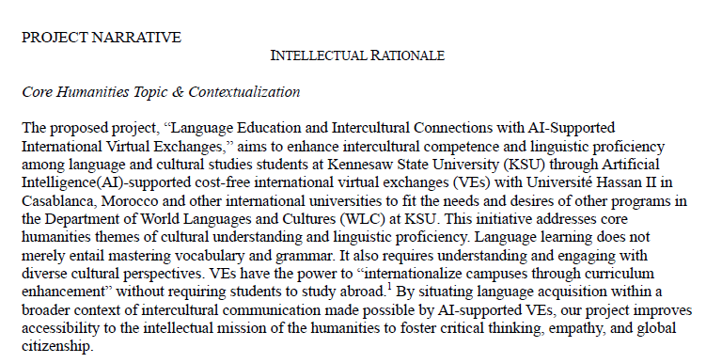

Slide 11
Questions for Participants
Which modalities would benefit the most from this for your program?
Is there a way the Saga Lab could support your program and/or VE?
Is there interest in applying for a grant to support this implementation?

Slide 12
IV. Curricular Development
Guiding Thread: “The Danger of a Single Story” (3:48 clip)
Support Activities for Active Weeks (implemented Fall 2023)
Introduction & Conclusion Activities (implemented Spring 2024)
Google Slides Collaborative Multimedia Deliverable (for Fall 2024)

Slide 13
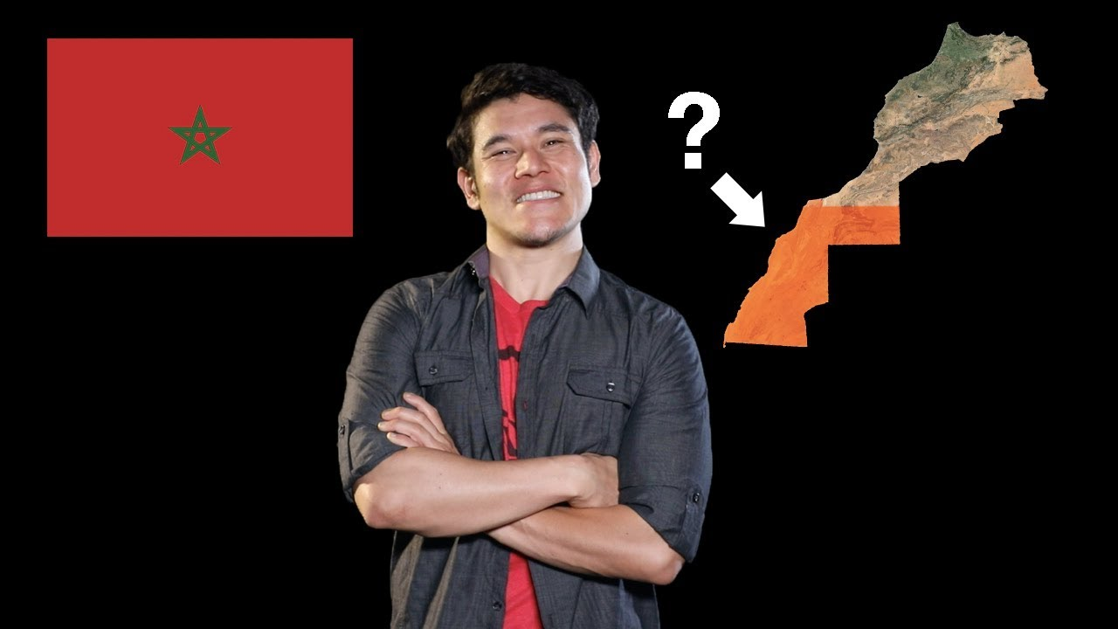

Slide 14
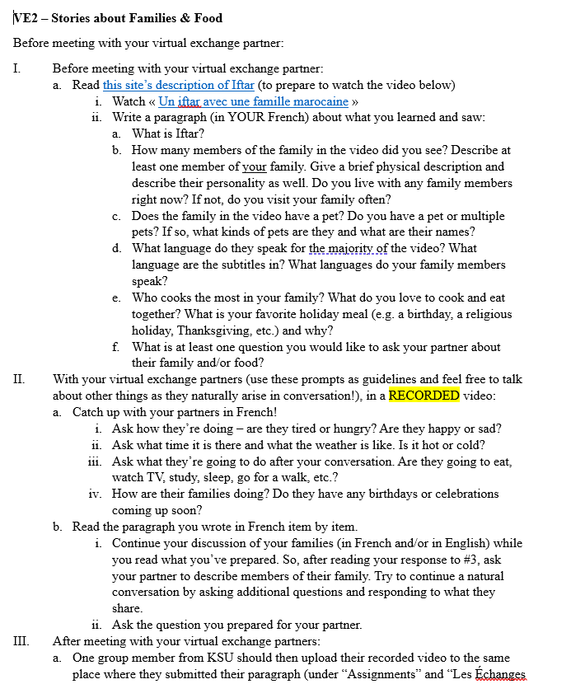

Slide 15
Questions for Participants
Do you have experience with similar collaborative activities?
If so, what platform(s) do you find most helpful for collaborative work?
If not, can you imagine how one could be incorporated in your program?

Slide 16
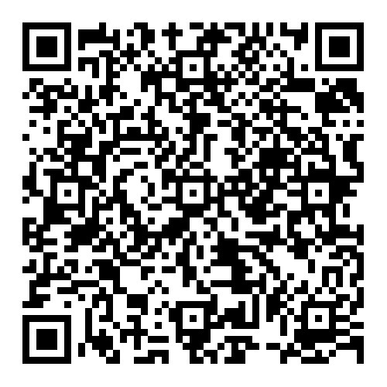
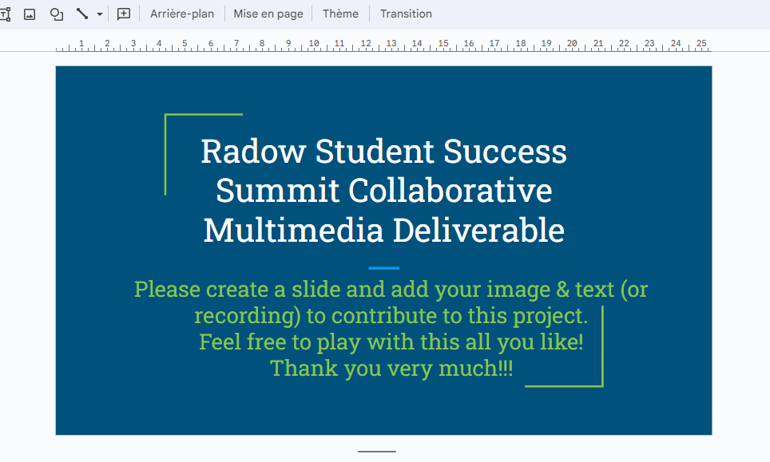
Concluding Interactive Activity
Please help me workshop this collaborative multimedia deliverable idea!
Let’s count off to assign a slide to each person starting at 2.
Scan the QR code, open the link (with a Google account), find and download an image reflecting part of our conversation (especially as it applies to your program’s possible future with VE, AI, etc.), and share your image & 1 sentence of explanatory text to your slide on our collaborative multimedia deliverable from this summit!

Slide 17
Thank you so much! aalex100@kennesaw.edu

