Slide 1
SUCCESS FROM THE STUDENTS’ PERSPECTIVE
Norman J. Radow College of Humanities & Social Sciences
Darina Lepadatu

Slide 2
What is Student Success?
The purpose of our project is to reveal the meaning and components of student success from existing research as well as students’ perceptions on the top factors that contribute to or hinder their success in a Sociology program.

Slide 3
Inside and Outside the Classroom
Advising & Mentoring
Experiential Learning
Undergraduate
Research
High Impact Practices
Student Success Tools &
Curricular Materials
Career Success
Professional Development of Faculty
USG Guidelines 2022

Slide 4
Academic Success
Transfer Students
Institutional Support
Student
Success
Life
Success
Diversity,
Inclusion &
Belonging
Socio-Economic Context

Slide 5
Problems Defining and Operationalizing “Student Success”
The Administrative Definition
The Faculty Definition
The Students’ Definition

Slide 6
Student Success in Teaching Sociology
Bridge Program for first gen students: hidden curriculum; students thrive in a collective learning environment (Castillo et al 2023)
Hybrid learning: students in hybrid courses had better outcomes than in f2f classes, especially minority students (Luna 2017)
Post-exam reflection exercise: importance of personal versus structural factors that affect student success; promotes confidence, motivation and a sense of mastery (Hattberg 2022)
Linking Sociology majors to labor market success: linking assignments to valuable skills (Ciabattari et al 2018)

Slide 7
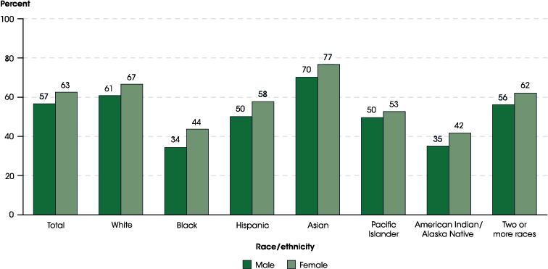
US College Graduation Rates by Gender and Race 2019
(National Center for Education Statistics 2019)

Slide 8
Sociology Graduates Demographics (Sociology Senior Student Success Survey, N=61) | Yes
Gender: Female Male Non-binary | 71% 20% 9%
Race African American/ black Hispanic White/ Caucasian Multiracial | 27% 23% 54% 5%
First generation to college | 20%
In a committed relationship | 23%
Raise a child/ children | 7%
Hold a full-time job | 26%

Slide 9
Aspects of Student Success (Sociology Senior Student Success Survey, N=61) | Yes
Different major before SOCI: One major Two majors 3 or more majors | 84% 63% 24% 13%
Considered quitting college | 57%
Transfer student | 54%
Type of classes attended: Mostly f2f Mix of f2f & online Mostly online | 14% 44% 42%
Plans to attend Graduate School | 64%
Job lined up after graduation | 34%

Slide 10
Student Success (Sociology Senior Survey)
Top Contributors:
Academic Skills (34%)
Family Support (25%)
Financial Aid (19%)
Support from faculty (17%)
Academic advising (5%)
Top Barriers:
Full Time Job (17%)
Mental Health Issues (17%)
Family Responsibilities (16%)
Course difficulty (12%)
Part-time Job (10%)

Slide 11
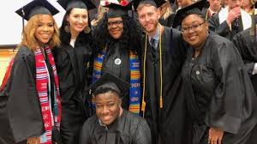
Recommendations from Seniors
See your advisor every semester
Keep students engaged
Change your major ASAP!
Career advising
More engagement with student organizations
Get involved with faculty research
Take advantage of all the resources available for students

Slide 12
Student Success Exercise
Last week Discussion Board:
-what challenges you have overcome to complete this course?
-what contributed to your success in this course?
-can you recommend some tips for student success for the next students?
-what is a favorite takeaway from this course?

Slide 13
Questions?

