Slide 1
A pre-internship course: Intersecting language, culture, and community engagement
(Background information on Student Success Summit Activity 1)
Kathy Negrelli
Student Success Summit Kennesaw State University 2024

Slide 2
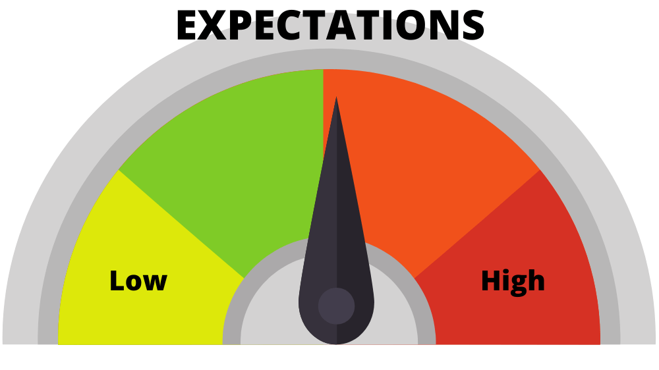
PURPOSE of the COURSE
help students be better prepared for INTERNSHIP
KNOWLEDGE OF: -- company culture -- appropriate communication -- how to work best with Japanese/ within a Japanese culture
LANGUAGE PROFICIENCY
1st time for ENG course offering in JAPN program
Notes:
1st time for ENG course offering in JAPN program

Slide 3
NEED for PRAGMATIC COMPETENCE intercultural/sociocultural perspectives of language use, specifically that used in social interactions

Slide 4
Domains of Thinking
1. Integrative thinking: connections between different concepts of Japanese culture, and between Japanese and Western concepts, demonstrating how they influence various practices, beliefs, customs, and values.
2. Intercultural thinking: evaluate generalizations about cultural groups, and analyze how cultural beliefs might affect communication across cultures
KSU Crit Th courses focus on sets of DOMAINS.
Notes:
KSU Crit Th courses focus on sets of DOMAINS.

Slide 5
OBJECTIVES of the COURSE
gain knowledge of the key Japanese cultural concepts
be able to communicate with people in Japan-related businesses and organizations in a culturally appropriate manner
increase participation in Japan-related events in Atlanta
gain familiarity with historic connections between Japan-related organizations & businesses in metro Atlanta and the state/people of Georgia

Slide 6
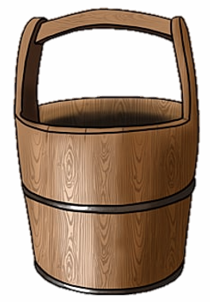
Japanese core cultural concepts
Japan-related entities in GA
“instructional”. Vs. “experiential”
Notes:
“instructional”. Vs. “experiential”

Slide 7
Requirements of the Course:
Join Japan-America Society of GA (JASG)
Attend 3 events; write synopses
This required getting to know the JASG and what they have to offer.
STUDENT SUCCESS SUMMIT - ACTIVITY 1
Website Scavenger Hunt

Slide 8
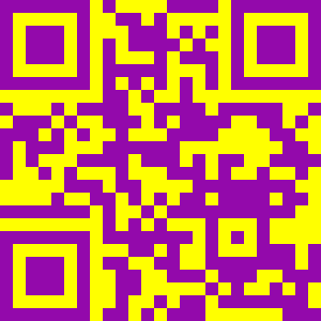

Slide 9
text
About JASG
Education
Membership
Events
Resources
-- History; -- Board of Directors; -- Japan-GA Peace Bell; -- Mike Mansfield Awards; -- Staff
-- Corporate members;
-- Membership survey;
-- Member spotlight;
-- Special offers for members
-- Upcoming events;
-- JapanFest;
-- Virtual Events archive;
-- Japan-America
Grassroots summit;
-- SEUS-Japan Conference
-- Japan Academic Challenge/Speech Contest;
-- Programs for Japanese students;
-- Host/Friendship Family Program
-- Japan-GA relationship;
-- Partnering organizations;
-- Job bank;
-- Internships;
-- Newsletter

Slide 10
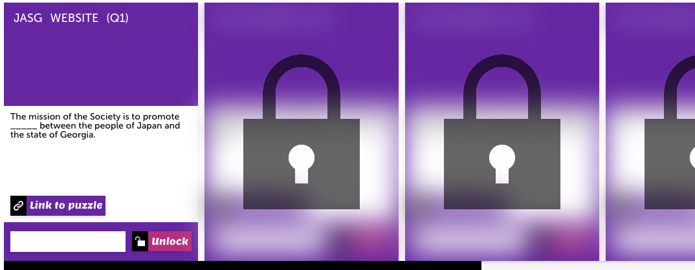
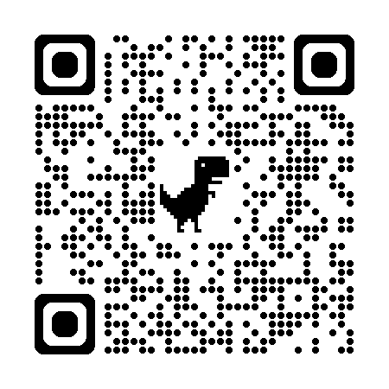
15 QUESTIONS 1. The mission of the JASG is to promote ___ between Japan & the people of GA. 2. JASG offers programs in the areas of business, culture, education, public affairs, and ____ _____. 3. In what year was the JASG established? 4. In 1976, the former GA Governor George Busbee, created the Southeast U.S.–Japan Association (abbreviated as ____-Japan) to promote trade, investment, understanding and friendship between Japan and the southeastern United States.
Notes:
https://puzzel.org/scavenger-hunt/play?p=-NYkM_wUD55B8BztLS0K

Slide 11
STUDENT SUCCESS SUMMIT - ACTIVITY 1
Begin creating a Website Scavenger Hunt for your course
1. Choose a website that is an integral site for your course. 2. Make a list of 5 or more essential facts that you want your students to search for.
3. Go to puzzel.org; click on Dashboard tab; select Scavenger Hunt under “Create New Puzzle”. Click START.

Slide 12
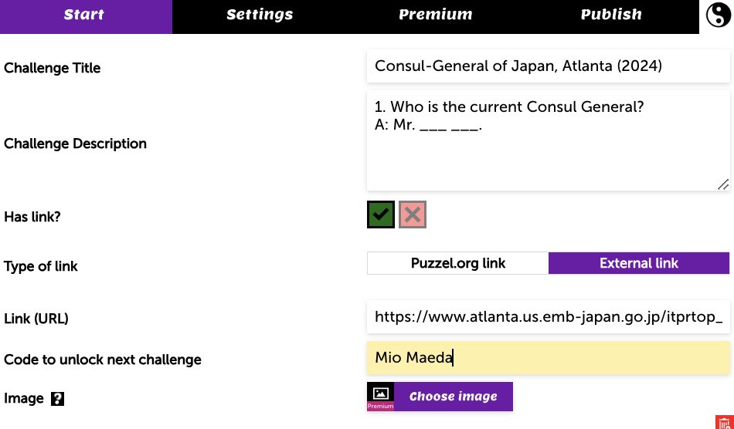
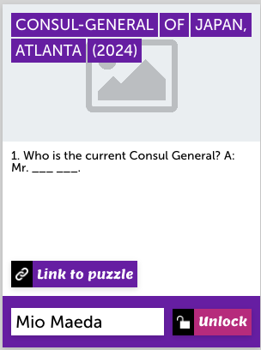
4. Add a TITLE . Pose your first question in the DESCRIPTION . Include the URL. Type the answer to the question/challenge next to CODE TO UNLOCK NEXT CHALLENGE.
5. You will see everything you input populate on the right side of the screen. Be sure to click SAVE CHANGES below it.
6. Click ADD CHALLENGE to input next question, and continue with remaining questions.

Slide 13
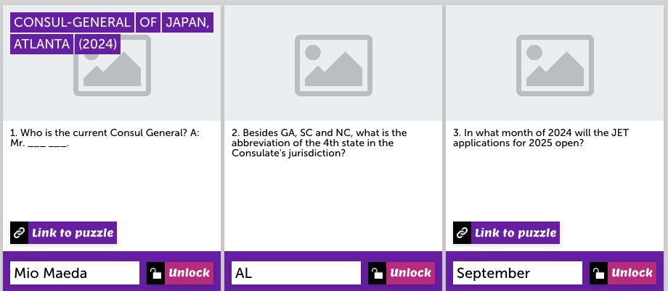
7. Continue inputting all questions. Play the puzzle and edit as needed.
8. When complete, click the SETTINGS tab to add the NAME of the puzzle.

Slide 14
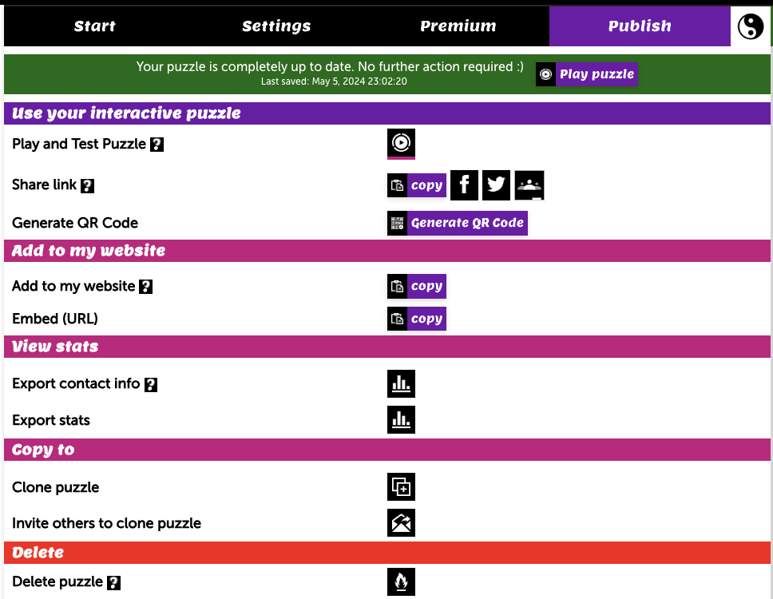
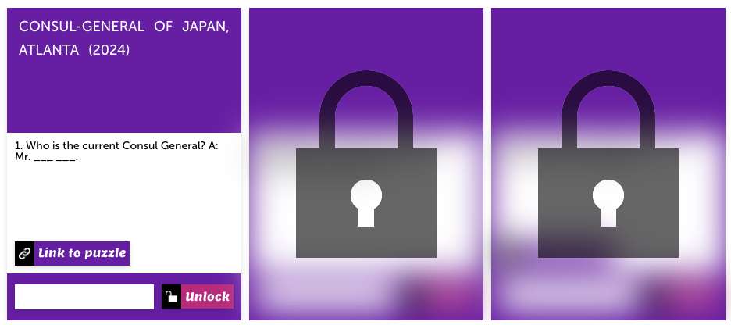
9. Click the Publish tab to generate a QR code or link to the puzzle.
10. Puzzle is ready to share with students!

Slide 15
V A R I A T I O N S
Create similar type of activity in other puzzle formats. (e.g., “Create Quiz”, “Create Fill in the Gap”).

