Slide 1
Using Flip for student engagement in asynchronous online classes
Rebecca Hill – Student Success Summit, KSU Spring 2024

Slide 2
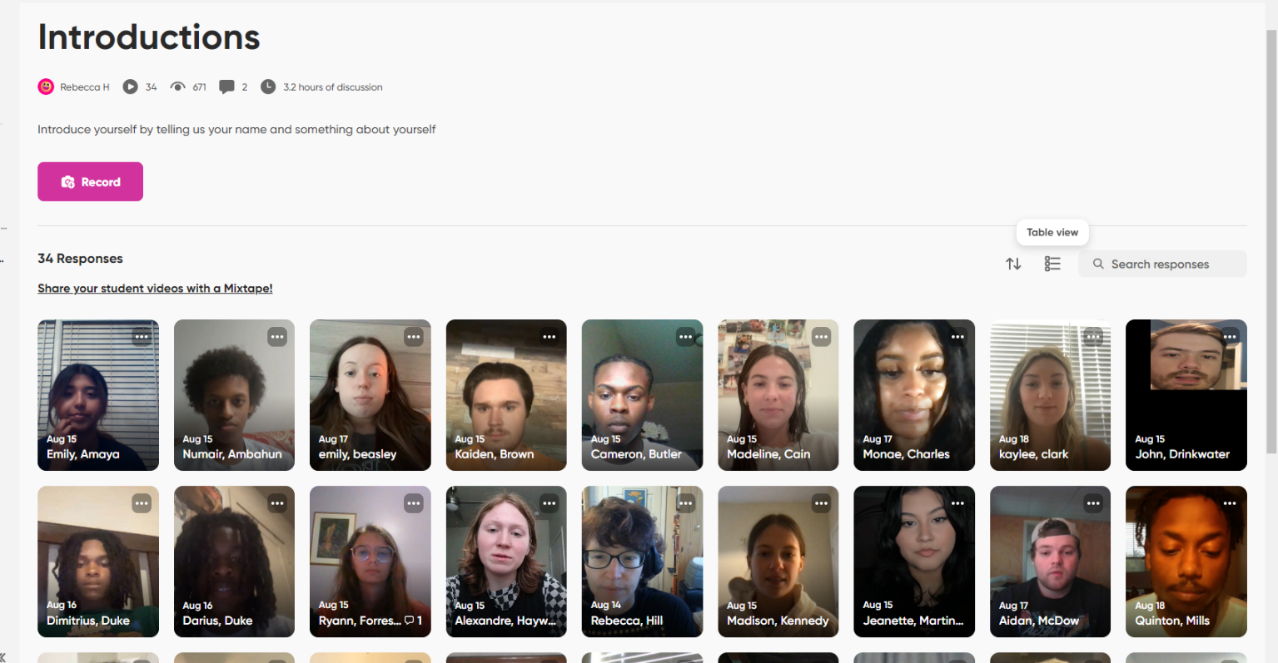
An example of a Flip Grid

Slide 3
From Student Sam Nova, AMST 1102 Fall 2023
I thought it was much more engaging than a simple discussion post type assignment which is common for online classes. I enjoyed seeing all of my classmates' responses as well! I think it helped with making the course feel more engaging than a traditional online course, which can sometimes feel a bit isolating when it's asynchronous.

Slide 4
From student Kcyana Redmon, AMST 1102 Fall 2023
Some thoughts I would like to share about Flip in relation to the class is it allowed students to see and essentially communicate with their classmates and additionally provided a new way to get the course materials across through these classmates. The Flip videos allowed students to see the different thoughts their classmates had on the course materials, instead of just having their own thoughts that wouldn't get challenged or agreed with. Although this was my first-time using Flip, compared to my other online courses where I just read text, watched videos, and answered the instructor's questions as well as responded to other students on the discussion board, I felt I was in an actual class with students, instead of names with no faces, and I was able to understand the materials of the course better due to the interactions with other students.

Slide 5
On using Flip for a longer presentation from John Drinkwater, AMST 1102 fall 2023:
flipgrid's internal video software made recording audio intuitive enough for this student to just hop in and add audio, slides, and background music all without having to watch a tutorial

Slide 6
What you can do with Flip
Personal introductions
Short discussion assignments – up to ten minutes for each video
Check-in with students about how they are doing
Presentations under 10 minutes long
Communicating with your class through your own short, informal videos

Slide 7
Example Flip Assignment – Discussion question and answer
Sample prompt from early in the semester, fall 2023:
1. Check-in question from me: It was a busy first week. How's it going so far? Do you have any questions for me about the class?
﻿
2. Ask your classmates a discussion question about anything in Rudnick chapter 2, chapter 7, the Cold War interview, or The Monsters are Due on Maple Street*
﻿
*Remember that good discussion questions are open-ended, about the assigned material and don't require classmates to do additional research beyond what was assigned....

Slide 8
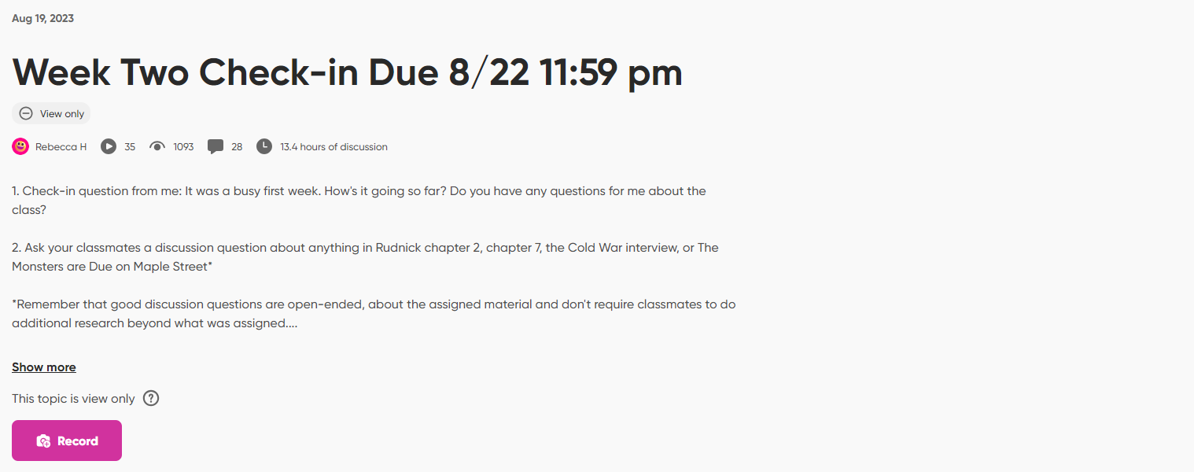
How it looks on Flip

Slide 9
Example of a student response
https://flip.com/groups/14172692/topics/37433819/responses/432003147/comments
It’s easy for students to make the short videos and easy for classmates to view and comment

Slide 10
You can use Flip to introduce yourself or for other things when you want to be more personable
My Flip intro: https://flip.com/groups/14172692/topics/37214247/responses/431288459/comments
You can use it as a way to post an assignment prompt: https://flip.com/groups/15197569/topics/41252262/responses/464446349/comments

Slide 11
Asking students to reflect on recent assignments and consider future assignments
1. Welcome back! Do you have any comments of questions about last week's pop-culture workshop? How do you think you could incorporate anything about changes in popular culture into your final paper for this class?
2. Ask your classmates a discussion question about anything in this week's Rudnick chapters or the podcast about Anita Bryant.
Sample student response, Cory Ridley Spring 2024: https://flip.com/groups/15326817/topics/41050947/responses/460755416/comments

Slide 12
Prompt students to prepare for upcoming assignments
Sample prompt:
1. If you've already done your second interview, what was the most interesting thing you learned? If you have not done your second interview yet, what is the first question you plan to ask?
2. Ask a discussion question for your classmates based on anything in this week's assigned readings or the documentary
Sample response: Kcyana Redmon, Fall 2023:
https://flip.com/groups/14172692/topics/38804301/responses/441740206/comments

Slide 13
Enable students to share their own research findings
1. Listen to at least three of your classmates' flip responses to my question about their interviews from last week. What did you notice about what they learned in their interviews that was a) interesting b) different from or similar to what you learned in your interview?
2. Ask your classmates a discussion question about this week's Rudnick chapters (17, 19 and 21) or the Black Panther Party platform, or my video lecture on the history of the US war in Vietnam
Sample student response, Julie Hall Spring 2024: https://flip.com/groups/15326817/topics/40553212/responses/456081087/comments

Slide 14
Problems with Flip
Some students don’t want to appear on video
Some students may have a technical issue with the website, especially a problem if you are using it for a longer presentation assignment
Some students are worried because this is commercial software and they fear they will be “on the web for all to see”
Some students read a script when making a video – it’s not AI proof
Student responses to classmate questions are mostly written comments and can therefore be composed by AI.
The maximum time is 10 minutes – it cannot be used for a longer presentation

Slide 15
Concluding Thoughts
It’s a video tool that enables students to interact more naturally as they do on platforms like TikTok
It allows you, the instructor, as well as the students, to get more of a feel for students in the class as whole people
Prompts can be more relaxed and informal
Responses are more authentic than what students post on text-based discussion boards
It’s not hard or more time-consuming to grade because the videos are short
Like any technology, it’s not perfect, but allows you to do things that you can’t do in a purely text-based environment
Having students present themselves with their faces and voices may give them more investment in the class and increase retention of students
You can start with very simple uses and expand from there as you and the students get more comfortable with the platform

