Slide 1
STRATEGIES TO ENSURE STUDENT SUCCESS IN THE ENGLISH CLASSROOM Oumar Chérif Diop
THEORIES
EXPECTANCY-VALUE
SELF-EFFICACY
AFFECTIVE DOMAIN
PRE-COURSE SURVEY
SCAFFOLDING
ANTICIPATION GUIDES
COMMONPLACE BOOK
GROUP WORK
LITERARY CIRCLES
May 13, 2024

Slide 2
AFFECTIVE DOMAIN
THE EXPECTANCY-VALUE
THEORY
SELF-EFFICACY THEORY
THEORIES

Slide 3
The Expectancy-Value theory
The Expectancy-Value theory evaluates the effort people are willing to put into a task. It considers two key factors: expectancy and value.
Expectancy: the degree to which people expect to be able to perform the task successfully.
Value: the degree to which people value the rewards and the opportunity to engage in the process involved in performing the task.
Research shows that people will not willingly invest effort in tasks that they do not enjoy and that do not lead to something they value even if they know that they can perform the tasks successfully, nor do they willingly invest effort in even highly valued tasks if they believe that they cannot succeed no matter how hard they try (Barkley and Howell 20).
MOTIVATION
ABILITY
REWARD
SUCCESS

Slide 4
Self-efficacy
The proponents of Self-efficacy theories suggest that students’ beliefs about their ability to succeed at a learning task are more important than their actual levels or difficulty. If the student is confident in her ability to perform a task successfully, she will be motivated to engage.
One of the fundamental ways teachers can help students expect to be successful in their course is by ensuring that learning activities and assessments promote success through clear organization, appropriate difficulty level, scaffolding of complex tasks, communication standards, and fair grading (Barkley and Howell 83).
MOTIVATION
ABILITY
SELF-CONFIDENCE
SUCCESS

Slide 5
AFFECTIVE DOMAIN (Barkley and Howell 83)
The affective domain taxonomy, sometimes called Krathwohl's taxonomy, was produced by Bloom in conjunction with Krathwohl and published later. Krathwohl's taxonomy is perhaps the best-known of all affective taxonomies.
The taxonomy is ordered according to the principle of internalization.
Internalization refers to the process whereby a person's effect toward an object passes from a general awareness level to a point where the effect is 'internalized' and consistently guides or controls the person's behavior.
This taxonomy addresses how we deal emotionally with feelings, values, appreciation, enthusiasm, motivation, and attitudes. As Cavanaugh (2019) suggests, cognitive resources are limited. We have limited attention and a finite working memory. She suggests that emotion is one of our best tools for engaging students.

Slide 6
AFFECTIVE DOMAIN (cont.)
Engaged affective learning is demonstrated by behaviors indicating attitudes of awareness, interest, attention, concern, responsibility, and the ability to listen and respond in interactions with others.
The taxonomy begins with “receiving,” followed by responding, valuing, organizing, and characterization.

Slide 7
AFFECTIVE DOMAIN (cont.) Receiving
Receiving: Paying attention to a text or a lecture, listening to others as they contribute to class discussion, being aware of or sensitive to the existence of certain ideas, material, or phenomena, and being willing to tolerate them, staying open to controversial issues, respecting the rights of others.

Slide 8
AFFECTIVE DOMAIN (cont.) Responding
Responding ranges from acquiescence to active response (e.g., reaction papers), completing assignments (e.g., the commonplace book entries), participating in discussion and small group activities, and engaging in new ideas, concepts, and theories.

Slide 9
AFFECTIVE DOMAIN (cont.) Valuing
Valuing is willing to be perceived by others as valuing certain ideas, materials, or phenomena. Spans simple acceptance of value to the more complex level of commitment.

Slide 10
AFFECTIVE DOMAIN (cont.) Organization
Organization: Emphasis put on comparing, relating, synthesizing, relating values to those already held, and bringing them into a harmonious and internally consistent philosophy.

Slide 11
AFFECTIVE DOMAIN (cont.) value
Characterization by value or value set is to act consistently per the values he or she has internalized. For example, students are willing to revise their views and works, to require assistance from instructors and peers, to be rated high in value, to manage learning-related issues, and to resolve them.

Slide 12
Self-Efficacy
theory
MOTIVATION
ABILITY
REWARD
SUCCESS
SELF-CONFIDENCE
ATTENTION
OPEN-MINDEDNESS
PREPAREDNESS
PARTICIPATION
COMMITMENT
ORGANIZATION
WILLINGNESS
Expectancy-Value
theory
Affective Domain
taxonomy

Slide 13
INSTRUMENTS
PRE-COURSE SURVEY
SCAFFOLD
ANTICIPATION
GUIDE
GROUP
WORK
COMMONPLACE
BOOK
LITERARY
CIRCLES
STRATEGIES

Slide 15
PRE-COURSE SURVEY
To know more about your students beyond what is shared in an introduction discussion.
Have students take a moment to reflect on success strategies before your course begins.
Help conduct a critical needs assessment about where your students are and what they want to accomplish in your course.
Because this takes place “behind the scenes” and is only shared with the instructor, rather than in a public discussion forum, the instructor may be more likely to receive candid responses.

Slide 16
8. What are three of the factors you imagine will be most impactful on your ability to participate fully in the course this semester?
9. Do you have concerns about being able to participate fully during our class time?
10. How do you enjoy learning?
11. When was the last time you had any interaction with this subject matter? What is your reason for taking this class now?
12. What are you most excited about in this course? What are you most worried about?
13. What is the most important thing you hope to learn from this course?
14. How do you feel you learn best? How do you know?
1. What do you want to get out of this course?
2. What would you like me to know about you and the circumstances under which you are learning this semester?
3. What should I know about you that would help me help you learn better?
4. Where do you do your work? Where do you read? Where do you watch videos?
5. In a few sentences, what is one of the most memorable/exciting/interesting things you learned last semester?
6. When was the first time you remember becoming interested in the subject of this course? Why?
7. Tell me one thing that you have found helpful in learning and studying that seems unique among your friends.
SAMPLE

Slide 17
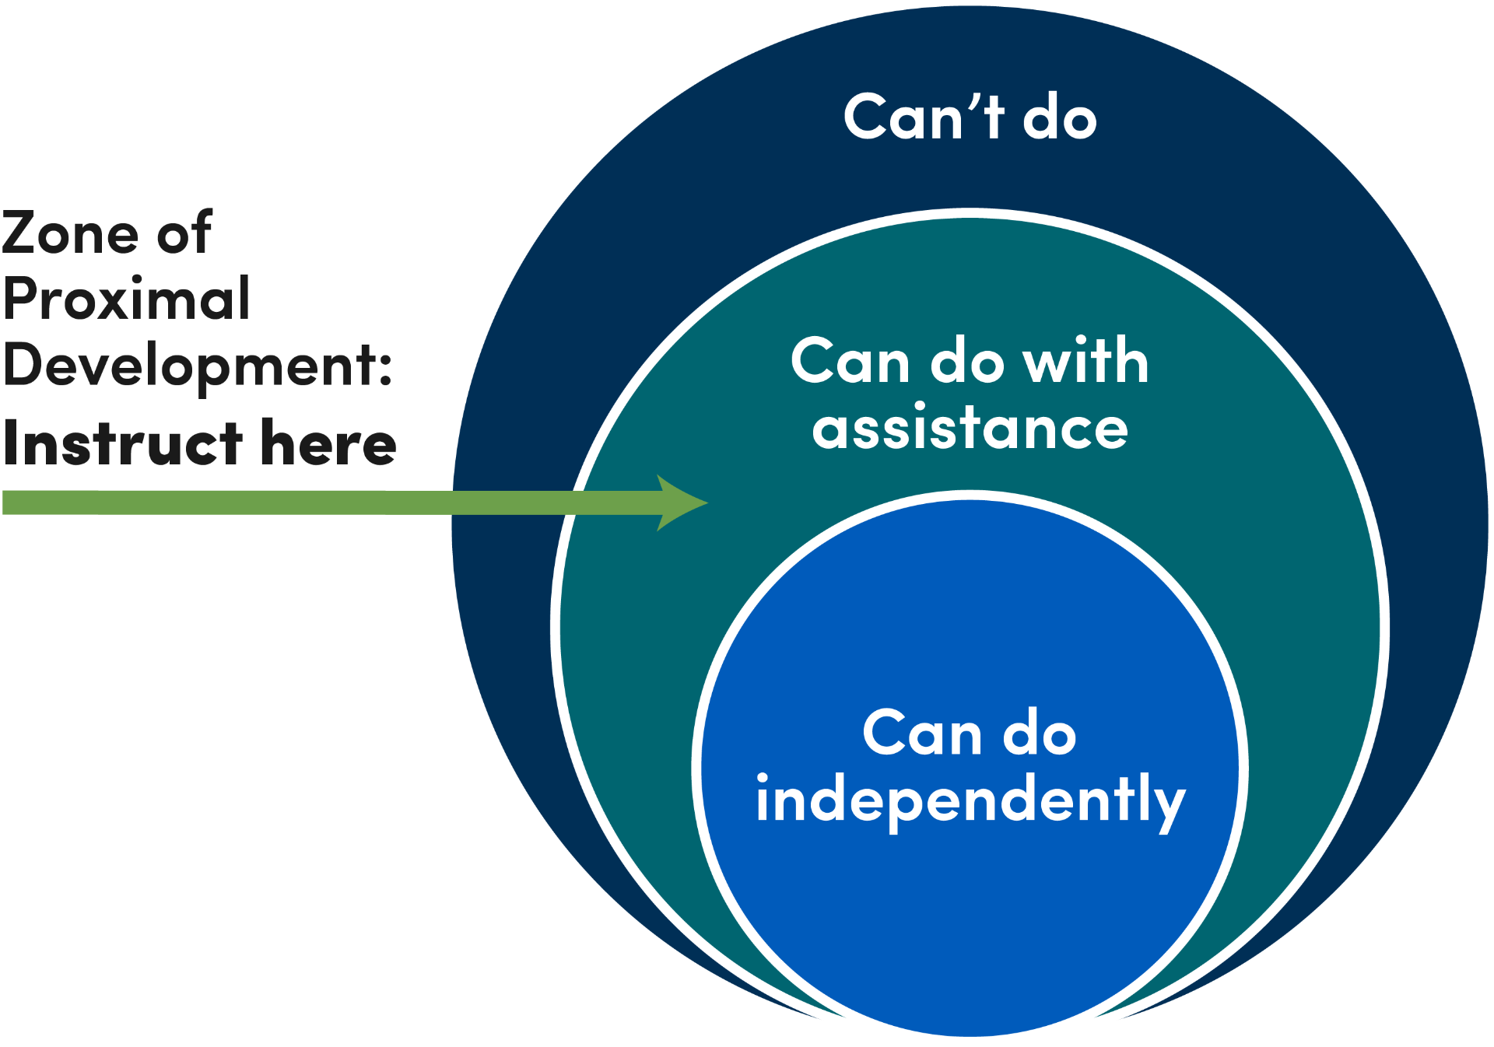
SCAFFOLDING

Slide 18
learner's developmental level
According to Lev Vygotsky, there are two parts to a learner's developmental level:
the "actual developmental level" (what a learner can do independently)
the "potential developmental level.“ (what a learner can potentially do with the help of a "more knowledgeable other.“)

Slide 19
The zone of proximal development
The zone of proximal development is "the distance between the actual developmental level as determined by independent problem solving and the level of potential development as determined through problem-solving under adult guidance, or in collaboration with more capable peers" (p. 86).

Slide 20
The zone of proximal development
In Vygotsky's words, the zone of proximal development "awakens a variety of internal developmental processes that can operate only when the learner is interacting with people in his environment" (p. 90).

Slide 21
The zone of proximal development
The zone of proximal development is critical for understanding how to scaffold learning. The more knowledgeable others share knowledge with the learner to bridge the gap between what is known and what is not.

Slide 22
"Through others, we become ourselves"
When the learner’s actual developmental level increases, the zone of proximal development shifts upward when the learner’s knowledge expands.
In other words, the zone of proximal development is ever-changing as the learner validates and extends knowledge. This process led Vygotsky to write: "Through others, we become ourselves" (Rieber, 1998, p. 170).

Slide 23
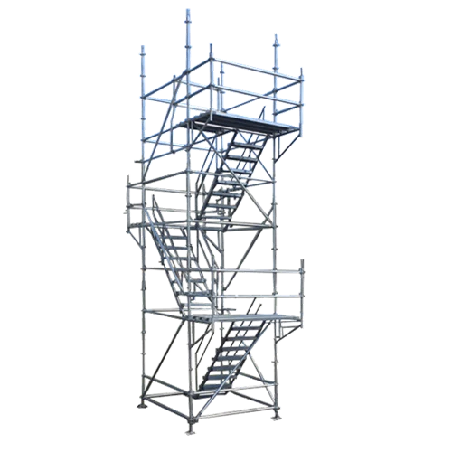
Wood, Bruner, and Ross (1976)
But Vygotsky did not use the term scaffold or scaffolding. The term scaffold, as applied to learning situations, comes from Wood, Bruner, and Ross (1976), who define it as a process "that enables a child or novice to solve a task or achieve a goal that would be beyond his unassisted efforts" (p. 90).
Scaffolds require control of those elements of the task that are initially beyond the learner's capability, thus permitting him to concentrate upon and complete only those elements within his range of competence.

Slide 24
SCAFFOLDING: 8 key features
A COMBINATION OF
Applebee and Langer (1983) five features and Puntambekar and Hübscher (2005) four features.

Slide 25
1. Intentionality
Intentionality: The task has a clear overall purpose driving any separate activity that may contribute to the whole.

Slide 26
2. Appropriateness
Appropriateness: Instructional tasks pose problems that can be solved with help but which students could not successfully complete on their own.

Slide 27
3. Structure
Structure: Modeling and questioning activities are structured around a model of appropriate approaches to the task and lead to a natural sequence of thought and language.

Slide 28
4. Internalization
Internalization: External scaffolding for the activity is gradually withdrawn as the patterns are internalized by the students. (Applebee & Langer, 1983 as cited in Zaho & Orey, 1999, p. 6)

Slide 29
5. Intersubjectivity.
Intersubjectivity. The first component necessary for instructional scaffolds to be effective involves the joint ownership of the task between the student(s) and teacher.
This requires that the task be defined and redefined by the student(s) and teacher such that the student(s) begin to understand the task from the perspective of the more knowledgeable other. As Wood and colleagues (1976) noted, this involves "making it worthwhile for the learner to risk the next step" (p. 98).

Slide 30
6. Ongoing diagnosis
Ongoing diagnosis. The teacher must be continually aware of what the learner understands and still needs to learn.
This requires a deep understanding of the task at hand, including the subtasks required for mastery, and a keen level of knowledge about the individual learner.

Slide 31
7. Dialogic and interactive
Dialogic and interactive. A third feature of learning scaffolds relates to the conversation that the student(s) and teacher have as part of the learning situation.
This is not a time for a monologue but rather a dialogue in which the teacher monitors student understanding and progress.
It requires a feedback system in which the teacher regularly checks for understanding and collects assessment information.

Slide 32
8. Fading
Fading. The final theoretical feature requires that the teacher fade the support provided to the learner(s).
In Vygotskian terms, this occurs when the learner has reached internalization.
Vygotsky (1978) hypothesized that cognition first occurs between people (interpsychological) before moving to (intrapsychological) within one's own self.
Without fading, this internalization process cannot happen; students become "prompt-dependent," not independent.

Slide 33
What teachers can do
to improve students’ comprehension
of content-area text.

Slide 34
DEFINITION
An anticipation guide is used before and after reading to activate students’ prior knowledge,
build curiosity about a new topic,
and evaluate how their perception of a topic has changed after reading or learning more about it.

Slide 35
Before reading a selection, students respond to several statements that challenge or support their preconceived ideas about key concepts in the text. This collaborative process stimulates students’ interest in a topic and sets a shared purpose for reading.
.
Anticipation guides should be revisited after reading to evaluate how well students understood the material, correct any misconceptions, and discuss new ideas and connections students made, fostering a sense of shared learning and understanding.

Slide 36
WHY USE ANTICIPATION GUIDES?
Anticipation guides are powerful tools that allow teachers to engage all students in exploring new information.
Anticipation guides stimulate students' interest in a topic and set a purpose for reading.
They challenge students to think critically about what they know or think they know about a topic and how they maintain or change ideas after learning more.
This is particularly beneficial for those students who may not initially be engaged by the topic, as it encourages them to take ownership of their learning journey.

Slide 37
HOW TO CREATE AND USE ANTICIPATION GUIDES
Consider what beliefs your students are likely to have about a topic.
Write general statements that challenge your students’ beliefs.
Require students to respond to the statements with either a positive or negative response.
Create space for students to return to the guide after reading to reevaluate their thinking.

Slide 38
STUDENTS USE THE GUIDE AS THEY WORK THROUGH THREE STEPS:
whether the textual evidence warrants modifying or qualifying one's perspective.
During reading: Read, document textual evidence, and consider multiple perspectives.
Before reading: Identify personal perspectives about the statements.

Slide 39
The Hunger Games Anticipation Guide
Statement | Agree or disagree? | Why? | After reading chapter 1, how do your thoughts compare to Katniss Everdeen’s?
It is never okay to kill humans.
Some rules are made to be broken.
Older siblings need to take care of their younger siblings.
Poaching is wrong.

Slide 41
ENGL 1102

Slide 42
WHAT IS "COMMONPLACING"
Commonplacing is the act of selecting important phrases, lines, and/or passages from texts and writing them down.

Slide 43
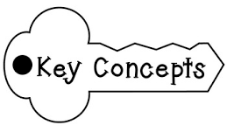
WHAT IS A COMMONPLACE BOOK?
Commonplace books are notebooks where readers collect from texts they read
quotations
key concepts
takeaways.

Slide 44
COMMONPLACE BOOK COMMENTS
Commonplace books also include comments and notes from the reader.

Slide 45
For each entry,
indicate the source, the author, and page numbers.
explain the content of the passage.
Most importantly, delve into the significance of the passage. Ponder over these intriguing questions. You're not obligated to answer all of them:
Does the passage captivate you with its boldness, distinctiveness, or originality? Why?
Is there a moment particularly moving? Why
Does the passage speak to something you’ve considered before or perhaps something you’ve read before (maybe in this class?)?
What do you notice about literary form, figurative language, etc.?
ENTRIES

Slide 46
CROSS-REFERENCE
Comments and notes are cross-referenced and indexed so the reader can classify common themes/topics and locate quotations related to them or authors.

Slide 47
A GOOD COMMONPLACE BOOK CHOICE of QUOTATIONS
A good commonplace book shows how attentive the reader is.
He/she notices
significant elements
Patterns
He/she raises issues, asks questions

Slide 48
A GOOD COMMONPLACE BOOK COMMENTARIES
A good commonplace book
comments on
the possible meanings
how particular words, phrases, or patterns in that quotation might lead us to a deeper sense of the text's meaning.
offers an explanation of the reasons for agreement or disagreement
takes into consideration the context in which the text was originally written in order to evaluate its possible meanings and effectiveness

Slide 49
A GOOD COMMONPLACE BOOK
Creates separate entries about separate texts
reflects the gradual development of the reader's understanding of literature.
refers to earlier texts to compare and/or contrast works or to consider the evolution of a particular way of thinking or writing.
As specific questions begin to strike the reader as particularly important, the commonplace logs will start to use those questions to explore those issues on a deeper level.

Slide 50
By keeping a commonplace book,
students become closer readers, critical thinkers about the nature of ideas and language, and adept manipulators of words and stylistic options.
Students are prepared for class discussions.

Slide 51
FORMAT
PASSAGES | COMMENTS
1------------------------------------------------------------------------------- | --------------------------------------------------------------------------------------------------------------------
2------------------------------------------------------------------------------- | -------------------------------------------------------------
3------------------------------------------------------------------------------- | ------------------------------------------------------------------------------------------------------------------------------------------------
TAKEAWAY: -------------------------------------------------------------------------------------------------------------------------------------------------------------------------------------------------------------------------------------------------------------------------------------------------------------------------------------------------------------------------------------------------------------------.

Slide 52
SAMPLE ENTRIES
NAME: __________________________ DATE: ________________
STORY TITLE: ________________________________
PASSAGES | COMMENTARIES
The soul, paralyzed in front of its true image, knew it was lost. It had been used to hiding in its refuge in the tall body of Don Damian; it had been used to everything… | People can lose their true image by being someone they are not. This soul felt as it was truly the most beautiful person because of what people would tell him. But were these people truly honest with this soul? What could cause this soul to feel so lost?
The soul of Don Damian, tired of so many lies decided to sleep. A moment later Don Damian sighed weakly and moved his head on the pillow. | Could this soul feel betrayed? Will this soul remember all these lies when awaken again? Will Don Damian change himself and actions when he is back to good health?
“Science is science, and my obligation is to do whatever I can to bring Don Damian back to life. You don’t find souls as beautiful as his just anywhere, and I can’t let him die until we’ve tried absolutely everything.” | How could the doctor say his soul is so beautiful? Does he truly know Don Damian or just the image Don Damian presents to him? As a doctor it was his job to nurse him to good health but when does he know enough is enough?
TAKEAWAY: -----------------------------------------------------------------------------------------------------------------------------------------------------------------------------------------------------------------------------------------

Slide 53
SAMPLE COMMONPLACE BOOK ENTRY
From Charlotte Smith, “On Being Cautioned Against Walking on an Headland Overlooking the
Sea, Because It was Frequented By a Lunatic” (41)
“Is there a solitary wretch who hies / To the tall cliff, with starting pace or slow, / And, measuring,
views with wild and hollow eyes / Its distance from the waves that chide below; / Who, as the sea-
born gale with frequent sighs / Chills his cold bed upon the mountain turf, / With hoarse, half-
utter’d lamentation, lies / Murmuring responses to the dashing surf?” (lines 1-8)
After discussing this poem in class, it strikes me how much of Smith’s verse is
devoted to her question: “Is there a madman in the hills?” If one of the things we expect from
lyric is first-person, subjective telling of his/her experience, what we seem to have here is less a
depiction of something Smith has seen but more of something she has imagined. As the title suggests, someone told her,
or “cautioned” her to stay away from that area because of the lunatic. But in
Smith’s poem, in her personal, subjective rendering of him, he hardly seems threatening at all—not
at all the sort of figure she should need to avoid out of fear that he might harm her. Why fear this
poor creature? His eyes may be “wild” (3), but they are also “hollow” (3); his pace may be frantic
as he moves “with starting pace or slow” (2); and he may be a “wretch” (1)—but he’s a “solitary
wretch” (1) who lies on a “cold bed” (6), alone, “murmuring responses” (8) to the only thing that
will talk to him, the “dashing surf” (8). How pathetic, how deeply sad.

Slide 54
SAMPLE COMMONPLACE BOOK ENTRY
After such a powerful depiction of such a devastated man, Smith’s line “I see him more with envy
than with fear” (10) seems startlingly wrenching. For this speaker, the rejected, ruined man—
someone people avoid and warn others to avoid, rather than helping him or reaching out to him—
is an object of envy. How much hatred for one’s mental experience—to envy the mind of a
madman.
I enjoy this poem tremendously, not least of which because of the tension between the dread other
people have told Smith she should have of the madman, and the clear sympathy—and empathy—
she has for him in this verse. I like the way she has taken a figure so easily demonized, the raving,
wandering lunatic, and turned him into an emblem for her own suffering, an emblem for social
isolation, and an emblem of a community’s cruel rejection.
But—I wonder if her melancholic stance, her posture of personal suffering, is maybe a bit
overblown, for dramatic effect perhaps? For me, I find her poem moving and deeply resonant; I
know what it is to envy other people for qualities and situations that might not seem so alluring to
the rest of the world, but seem desirable to me. But I can also see why others might view her
sentiment as a bit too much, a bit too affected

Slide 55
GROUP WORK

Slide 56
GROUP WORK
Lev Vygotsky’s Social Learning Theory identified a link between peer learning and intrinsic motivation.
Vygotsky also found that students can more easily learn complex ideas from other students than from teachers.
Because there is less of a knowledge gap between peers, students benefit from explanations given by a “knowledgeable other” their age.
As a result, strong students deepen their understanding by explaining their ideas, while their peers benefit from another way to learn.
Students can also divide responsibilities so that each student leverages their greatest strengths.
In addition to the academic benefits, group work supports social-emotional learning. When students learn in groups, they are developing communication skills, self-regulation, and metacognition.

Slide 57
GROUP WORK BENEFITS
INCREASED
INDIVIDUAL
ACHIEVEMENT
ENHANCED
COMMUNICATION
https://ctl.wustl.edu/resources/benefits-of-group-work/

Slide 58
INCREASED INDIVIDUAL ACHIEVEMENT
Students engaged in group work or cooperative learning show increased individual achievement compared to students working alone. For example, in their meta-analysis examining over 168 undergraduate student studies, Johnson et al. (2014) determined that students learning in a collaborative situation had greater knowledge acquisition, retention of material, and higher-order problem-solving and reasoning abilities than students working alone.
There are several reasons for this difference. Students’ interactions and discussions with others allow the group to construct new knowledge, place it within a conceptual framework of existing knowledge, and then refine and assess what they know and do not know.
This group dialogue helps them understand what they are learning and what they still need to understand or learn (Ambrose et al. 2010; Eberlein et al. 2008).
In addition, groups can tackle more complex problems than individuals can and thus have the potential to gain more expertise and become more engaged in a discipline (Qin et al 1995; Kuh 2007).
Group work creates more opportunities for critical thinking and can promote student learning and achievement.

Slide 59
ENHANCED COMMUNICATION
Student group work enhances communication and other professional development skills. Estimates indicate that 80% of all employees work in group settings (Attle & Baker 2007). Therefore, employers value effective oral and written communication skills as well as the ability to work effectively within diverse groups (ABET 2016-2017; Finelli et al. 2011).
Creating facilitated opportunities for group work allows students to enhance their skills in working effectively with others (Bennett & Gadlin 2012; Jackson et al. 2014).
Group work gives students the opportunity to engage in process skills critical for processing information and evaluating and solving problems, as well as management skills through the use of roles within groups and assessment skills involved in assessing options to make decisions about their group’s final answer.
All of these skills are critical to successful teamwork both in the classroom and the workplace.

Slide 60
GROUP WORK TECHNIQUES
THINK- PAIR-SHARE
SNOWBALLING
STRUCTURED CONVERSATION
TALKING TRIADS
THREE-STEP INTERVIEW
RECIPROCAL QUESTIONING
ROUNDTABLE
JIGSAW METHOD

Slide 61
Think-Pair-Share
The instructor poses a question. Students are given time (30 seconds or one minute) to think of a response. Each student then pairs with another and both discuss their responses to the question. The instructor invites pairs to share their responses with the class as a whole.

Slide 62
Structured Controversy
Divide the class into groups of four. The instructor identifies a controversial topic in the field covered in the course and gathers material that gives information and background to support different views of the controversy. Students work with one partner, forming two pairs within the group of four. Each pair takes a different side of the issue. Pairs work outside of class or in class to prepare to advocate and defend their position. The groups of four meet, and each pair takes a turn stating and arguing its position while the other pair listens and takes notes without interrupting. Each pair must have a chance both to listen and take notes and to argue their position. Then all four talk together as a group to learn all sides of the issue. Next, each pair must reverse its position and argue the opposite position from the one it argued before. Lastly the group of four as a whole discusses and synthesizes all the positions to come up with a group report. There may be a class presentation in which each group presents its findings.

Slide 63
Roundtable
Students in small groups sit in a circle and respond in turn to a question or problem by stating their ideas aloud as they write them on paper. The conversation can go around the circle, each student in turn, more than once if desired. After the roundtable, students discuss and summarize the ideas generated and report back to the class.

Slide 64
Three-Step Interview
This can be used as an icebreaker or as a tool to generate ideas and discussion. Ask each student to find one partner they don’t know well. Make sure everyone has a partner. You can use triads if there is an uneven number of students in the class. Students interview their partner for a limited amount of time using interview questions given by the instructor. Often questions are opinion- or experience-generated: How do you use writing in your daily life? Should premed students study holistic medicine? After a set time, students switch roles so that both get a chance to be interviewed. Then, join each pair with another pair to form a group of four. Each partner in a pair introduces the partner to the other pair and summarizes the partner’s responses. Other variations on this activity are possible.

Slide 65
Reciprocal Peer Questioning
The instructor assigns outside class reading on a topic. The instructor asks students to generate a list of two or three thought-provoking questions of their own on the reading. (Note that asking productive questions can be a new skill for students to learn; you may want to give some attention to this.) Students bring the questions they have generated to class. Students do not need to be able to answer the questions they generate. Students then break into teams of three to four. Each student poses her questions to the team and the team discusses the reading using the student-generated questions as a guide. The questions of each student are discussed within the team. The team may then report back to the class on some key questions and the answers they came up with.

Slide 66
Snowballing
Similar to the ‘square’ approach mentioned in ‘Think-Pair-Square’, the ‘snowballing’ activity is another simple but very effective way of building upon ideas by starting with small groups and expanding the groups in a structured way. As the metaphor of the snowball suggests, you can begin with an individual response to a question; followed by then pairing up students up; then creating a four and so on. It does allow for quick, flexible group work that doesn’t necessarily require much planning, but does keep shaping viewpoints and challenging ‘answers’ is a constructive fashion.

Slide 67
Talking Triads
Another simple, but highly effective strategy. It is a strategy that gets people to explore a chosen topic, but with a really rigorous analysis of ideas and views. The triad comprises of a speaker, a questioner and a recorder/analyst. You can prepare questions, or you can get the questioner and the analyst to prepare questions whilst the speaker prepares or reflects upon potential answers. This can be done in front of the class as a gallery of sorts, or you can have all triads working simultaneously. If they do work simultaneously, then a nice addition is to raise your hand next to a particular triad, which signals for other groups to stop and listen whilst that specific triad continues, allowing for some quality listening opportunities.

Slide 68
the Jigsaw method
When researching a topic, like the causes of the Second World War, each member of a group is allocated an area for which they need to become the ‘expert‘, such as ‘the impact of the Treaty of Versailles’, or ‘issues with the dissolution of Austria-Hungary’ for example. With five or six ‘Home‘ groups identified, the ‘experts‘ then leave that group to come together to pool their expertise on the one topic; they question one another and combine research, ideas and their knowledge. Then each ‘expert‘ returns to their ‘home‘ group to share their findings. It is a skilful way of varying group dynamics as well as scaffolding learning.

Slide 69
the Jigsaw method https://www.teachervision.com/group-work/jigsaw-groups-for-cooperative-learning
Jigsaw is a grouping strategy in which the class members are organized into "jigsaw" groups.
The students are then reorganized into "expert" groups containing one member from each jigsaw group.
The expert group members work together to learn the material or solve the problem, then return to their "jigsaw" groups to share their learning.
In this way, the work of the expert groups is quickly disseminated throughout the class, with each person taking responsibility for sharing a piece of the puzzle.
Jigsaw is an efficient way for students to become engaged in their learning, learn a lot of material quickly, share information with other groups, minimize listening time, and be individually accountable for their learning.
Since each group needs its members to do well for the whole group to do well, Jigsaw maximizes interaction and establishes an atmosphere of cooperation and respect for other students.

Slide 70
Jigsaw Groups:
Group One | Group Two | Group Three | Group Four
Nucleus (Kathy) | Nucleus (Susan) | Nucleus (Jose) | Nucleus (Jim)
Mitochondria (Jorge) | Mitochondria (Randy) | Mitochondria (Gail) | Mitochondria (Tan)
Cell Wall (Sara) | Cell Wall (Andy) | Cell Wall (Chris) | Cell Wall (Julie)
Protoplasm (Heather) | Protoplasm (Jessenia) | Protoplasm (Phu) | Protoplasm (Karen)

Slide 71
Expert Groups:
Group One | Group Two | Group Three | Group Four
Nucleus (Kathy) | Mitochondria (Jorge) | Cell Wall (Sara) | Protoplasm (Heather)
Nucleus (Susan) | Mitochondria (Randy) | Cell Wall (Andy) | Protoplasm (Jessenia)
Nucleus (Jose) | Mitochondria (Gail) | Cell Wall (Chris) | Protoplasm (Phu)
Nucleus (Jim) | Mitochondria (Tan) | Cell Wall (Julie) | Protoplasm (Karen)

Slide 72
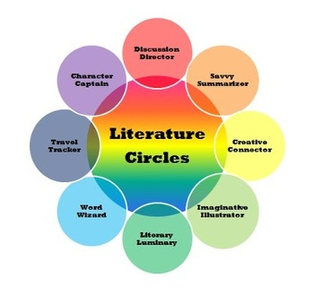
Adapted from Lorraine Cella’s Response to English Journal’s “The Round Table” October 1992.

Slide 73
LITERATURE CIRCLES
Adapted from original by Ed Youngblood
(South Gwinett High School, Lawrenceville, GA)
and from Lorraine Cella’s response to English Journal’s “The Round Table” October 1992.

Slide 74
LITERATURE CIRCLES
the goal of literature circles is to facilitate peer-based learning.
In literature circles, small groups of students gather to discuss a piece of literature in depth. The discussion is guided by students' responses to the text.
Students may talk about events and characters in the book, the author's craft, or their personal experiences related to the story.
Literature circles provide a way for students to engage in critical thinking and reflection as they read, discuss, and respond to books.
Collaboration is at the heart of this approach, where students not only share their understanding but also shape and add to it, fostering a sense of teamwork and shared learning.
Finally, literature circles guide students to a deeper understanding of what they read through structured discussions, providing a clear and directed path to comprehension, and extended written and artistic response.

Slide 75
ROLES
THE DISCUSSION DIRECTOR develops a list of questions (at least 10) about the reading. Starts the discussion and makes sure the discussion stays on track.
THE PASSAGE MASTER locates a few special reading sections the class should reflect on. The idea is to help people notice the most significant passages of the text.
THE CONNECTOR finds connections between the reading and experiences as a reader.
CONFLICT MANAGER identifies and analyzes the different conflicts in the text.
THE PLOT EXPERT
THE SETTING OBSERVER

